Slide 1


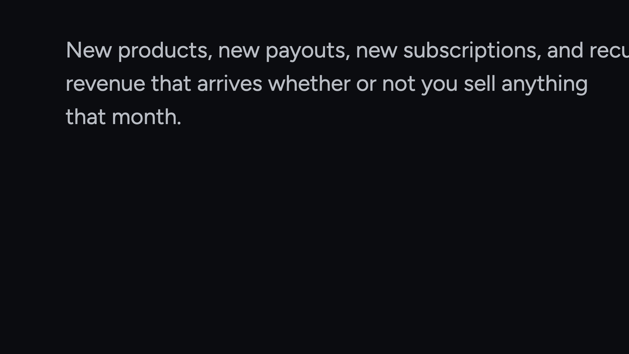

Notes:
Set the frame: this is a company with a track record and a plan that starts from zero today. Twenty seconds, then move.

Slide 2


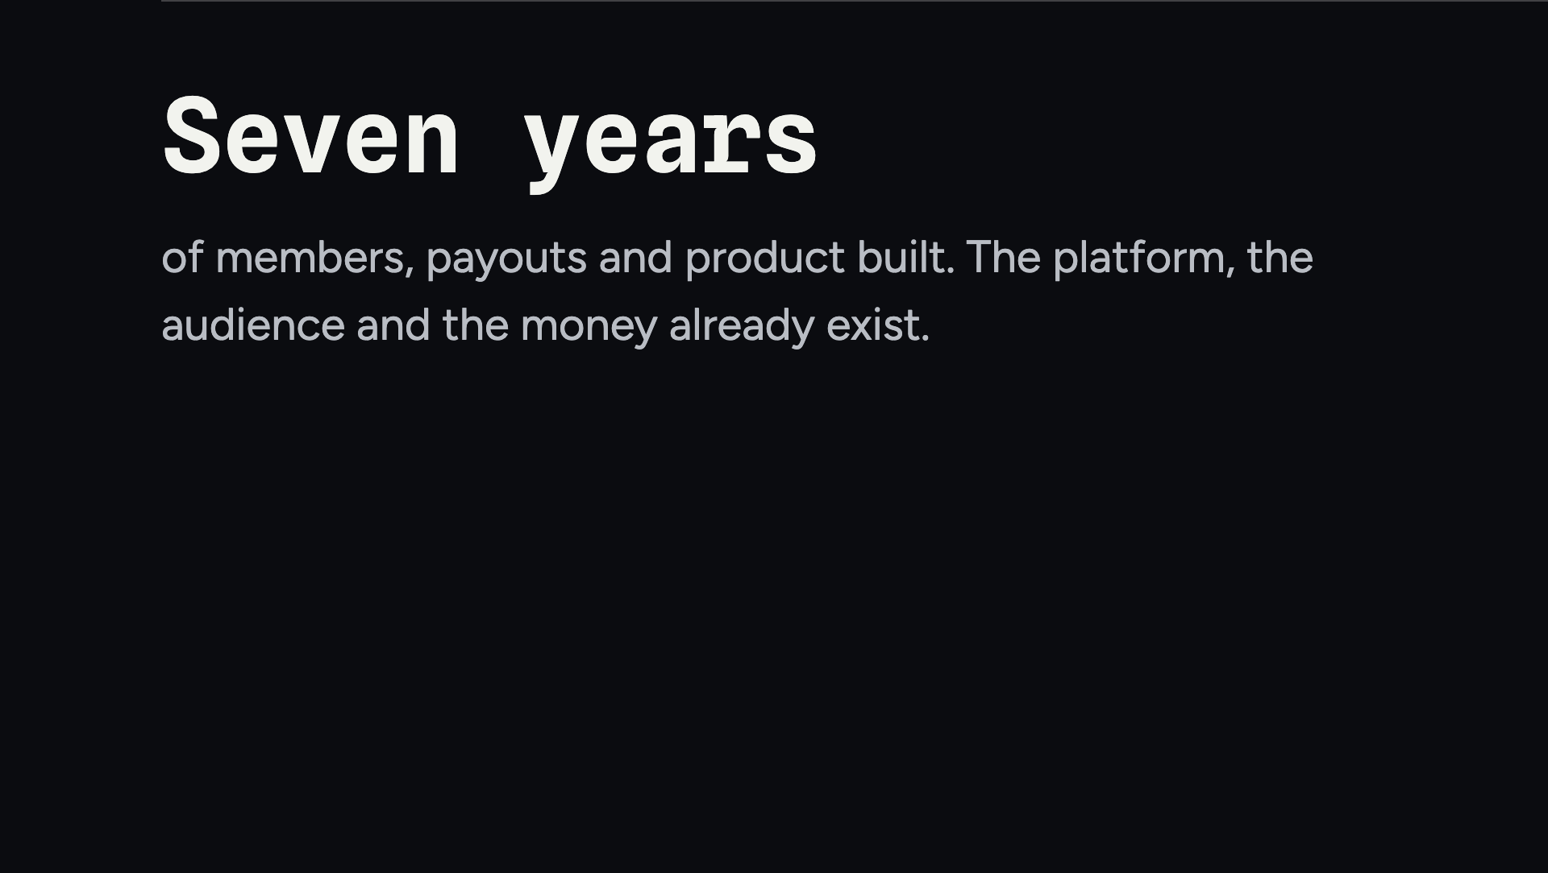
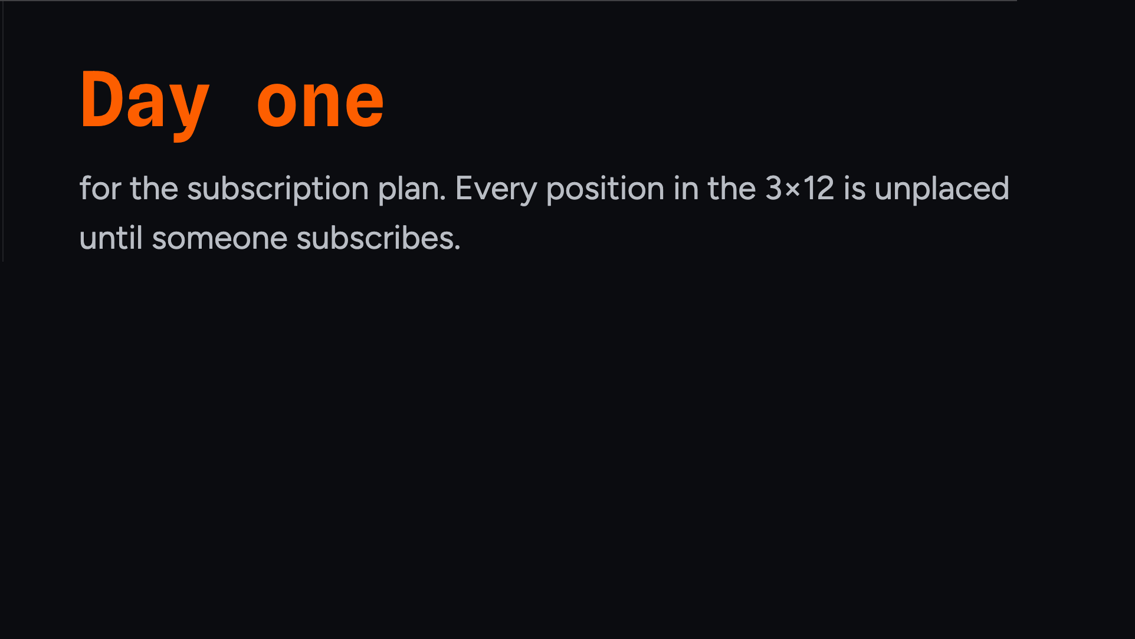
Notes:
This is the whole argument in one slide. History on the left, a clean start on the right.

Slide 3
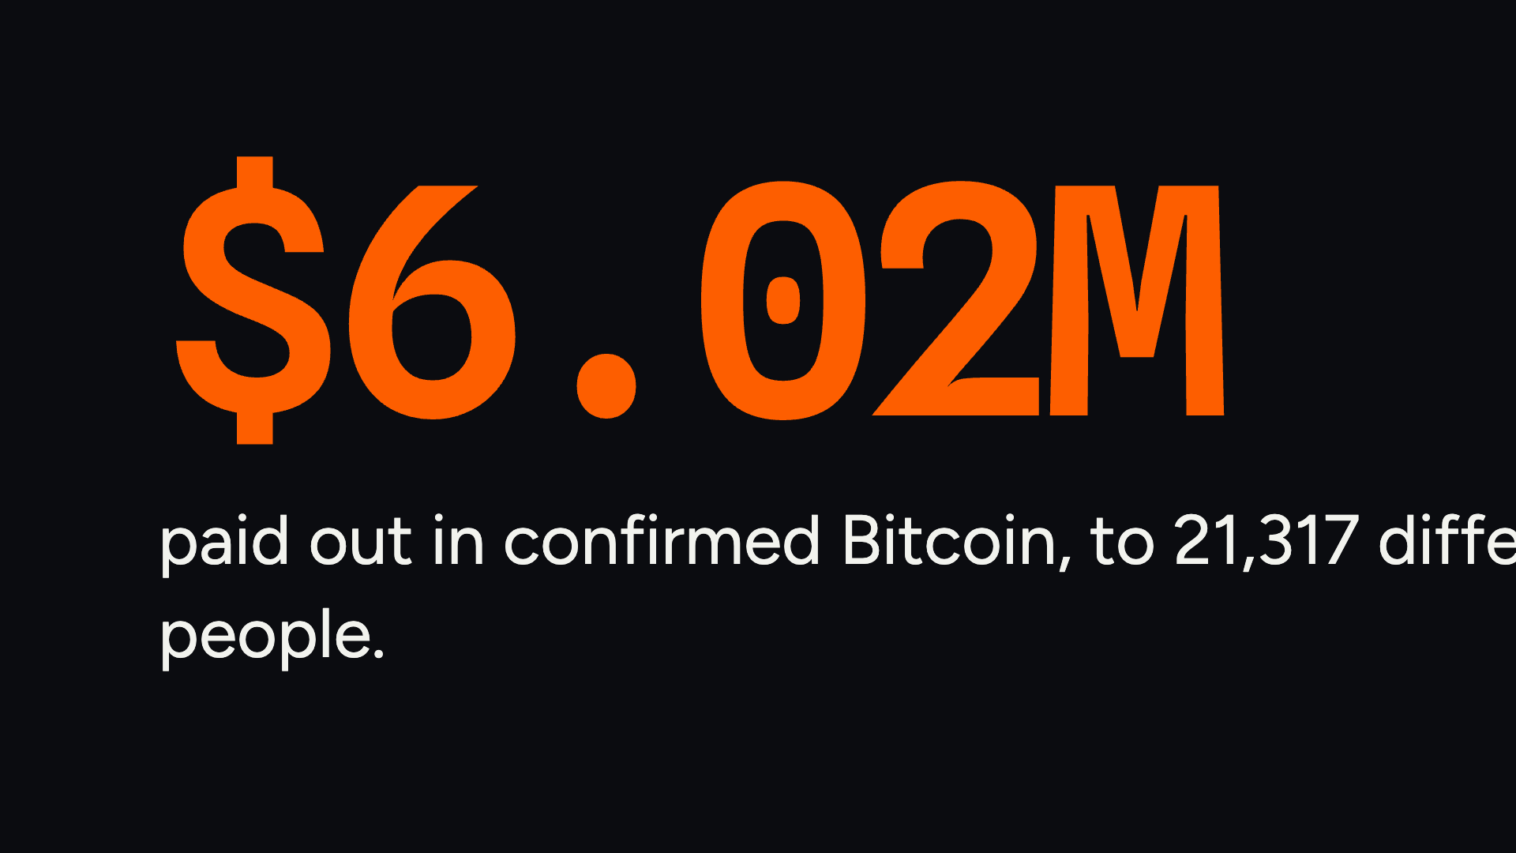
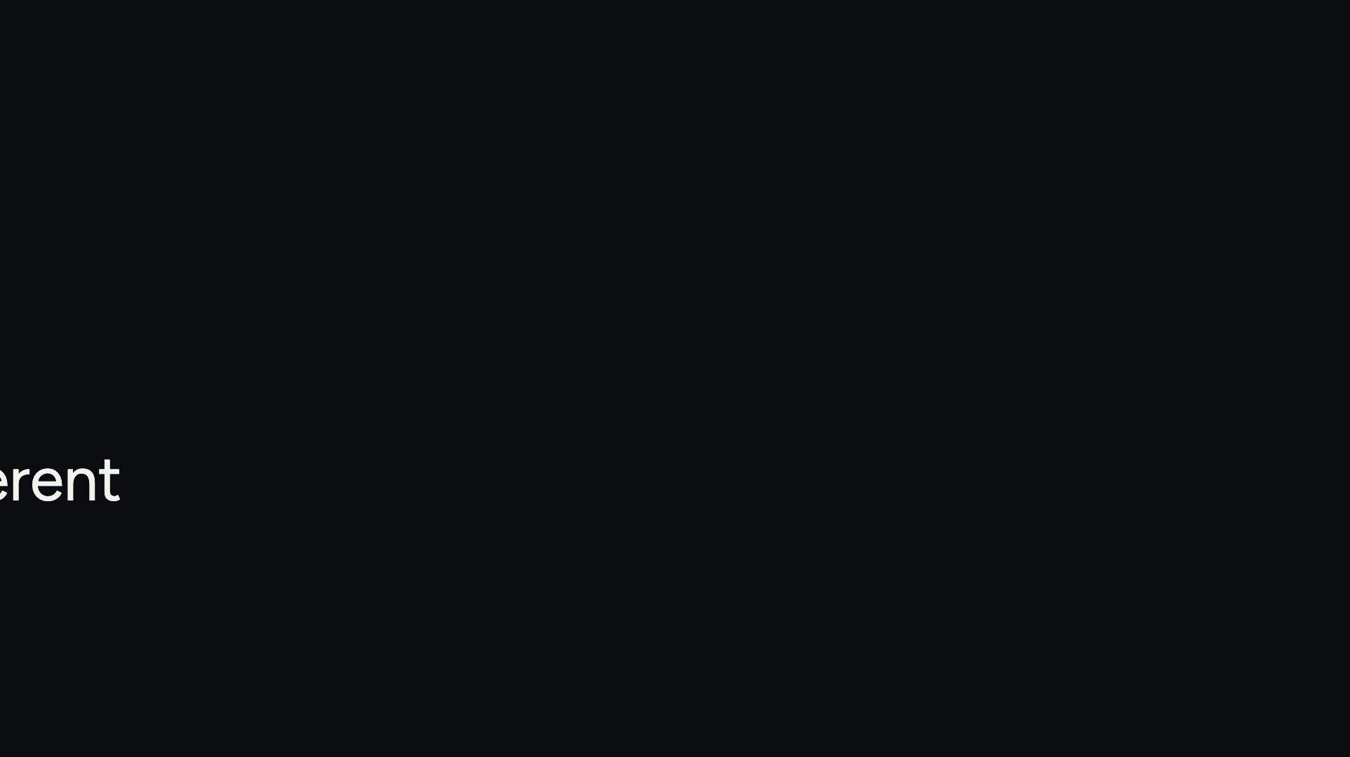
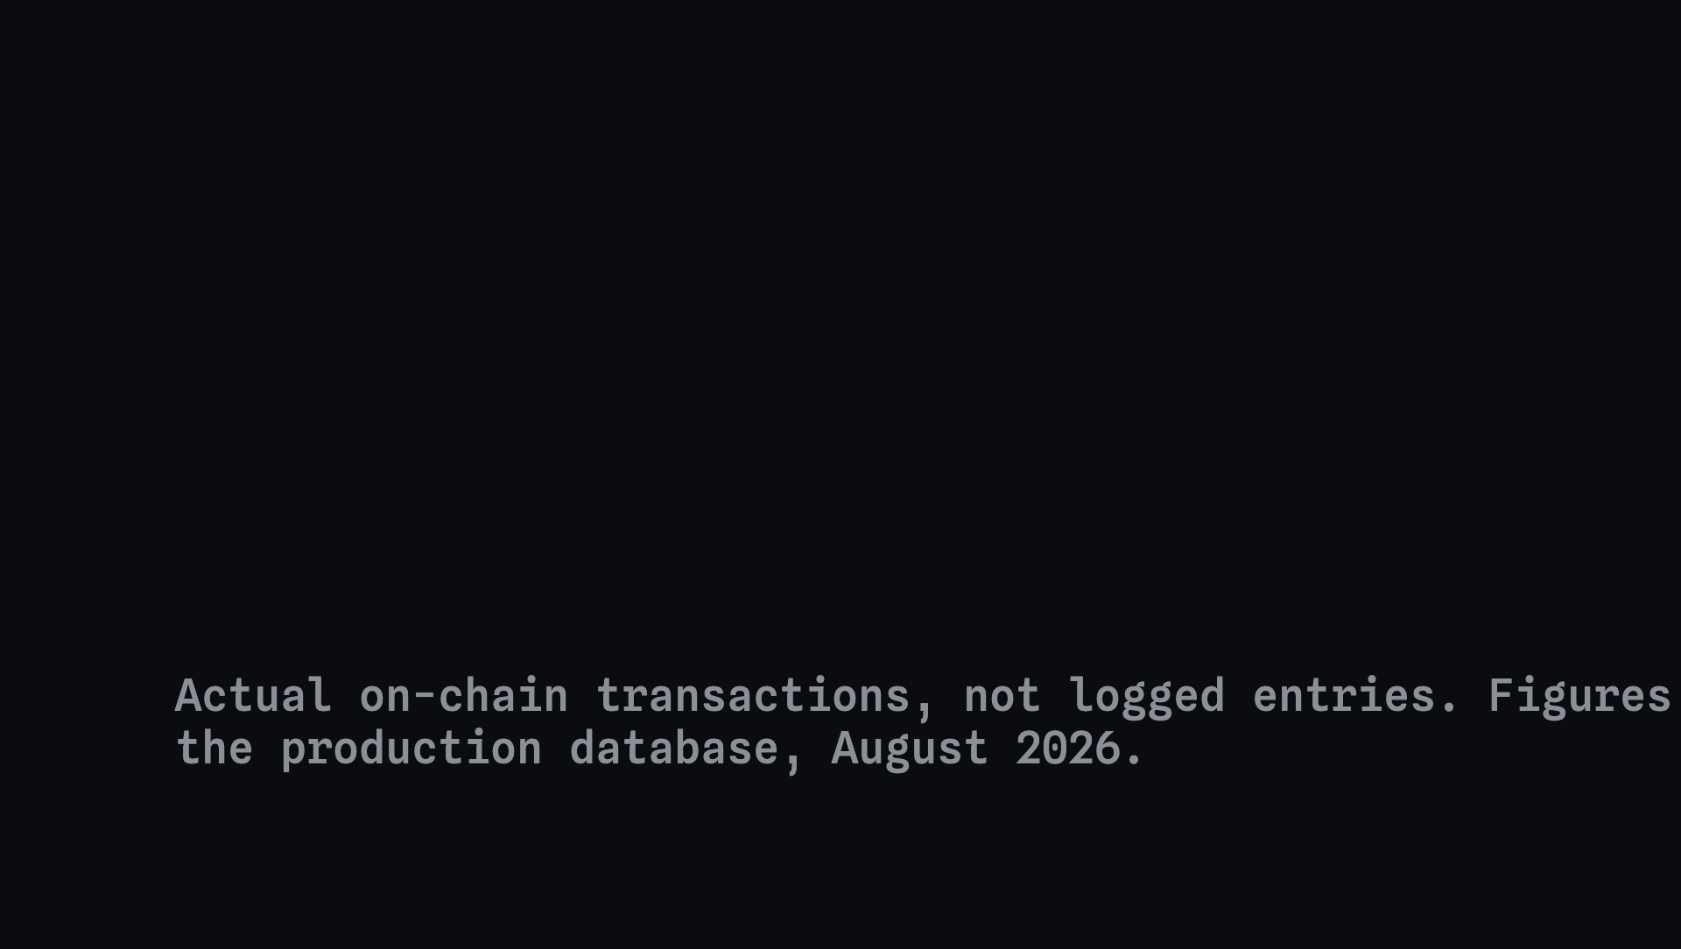
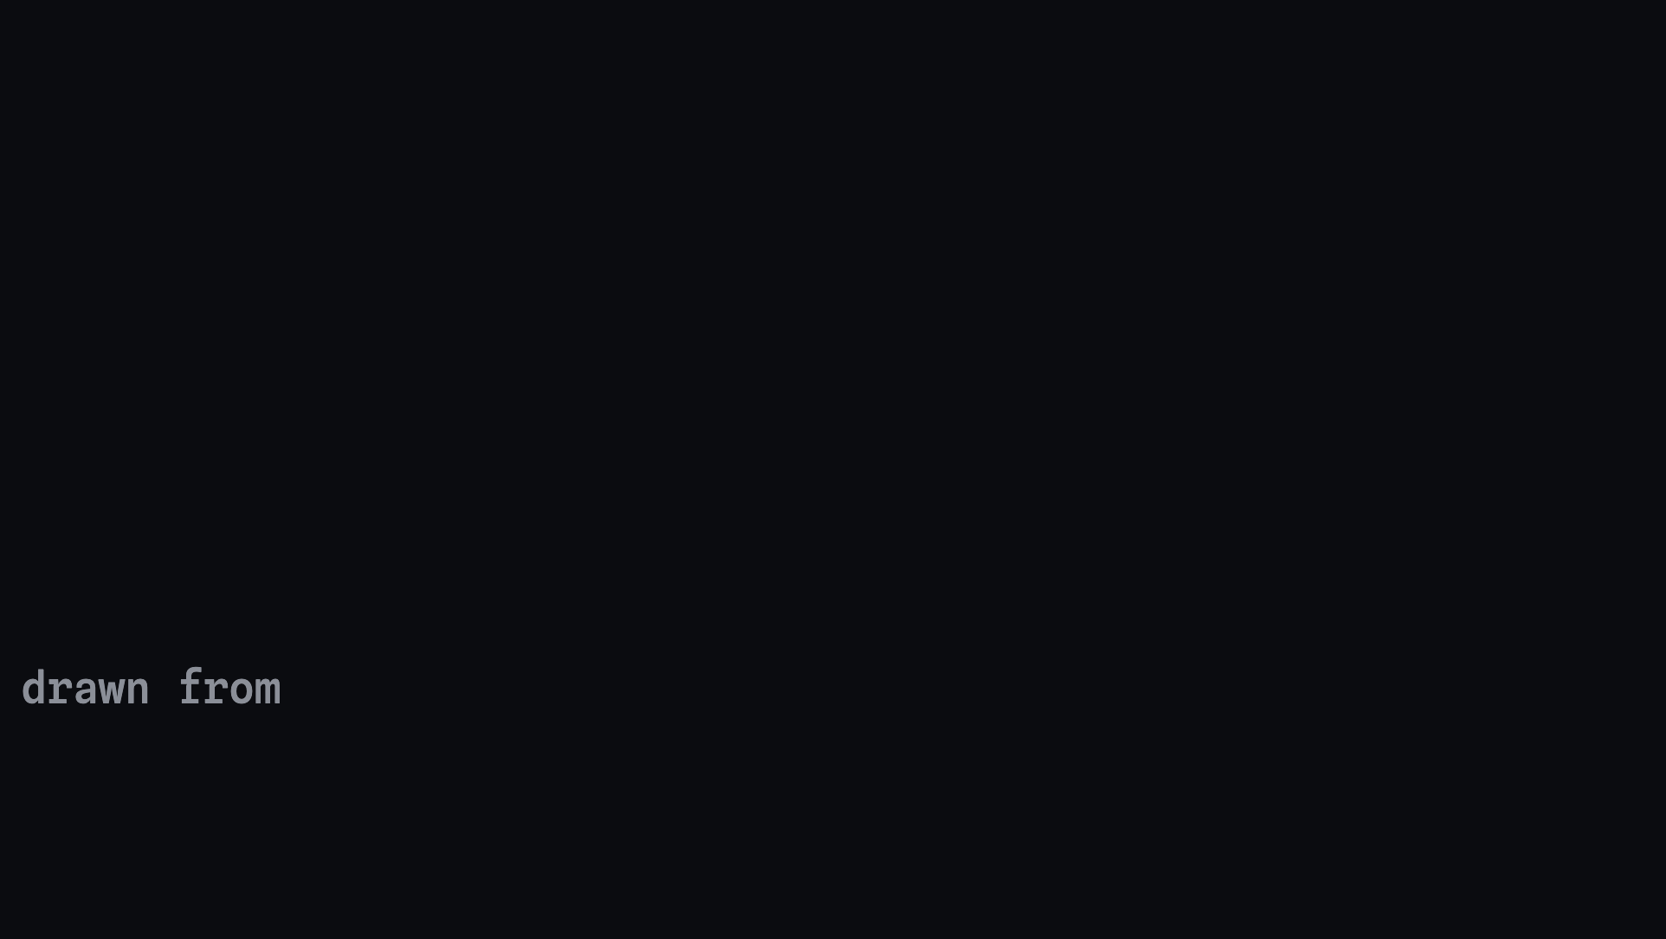
Notes:
Say it plainly: this is money that left the company and arrived in members' wallets. On-chain, verifiable.

Slide 4
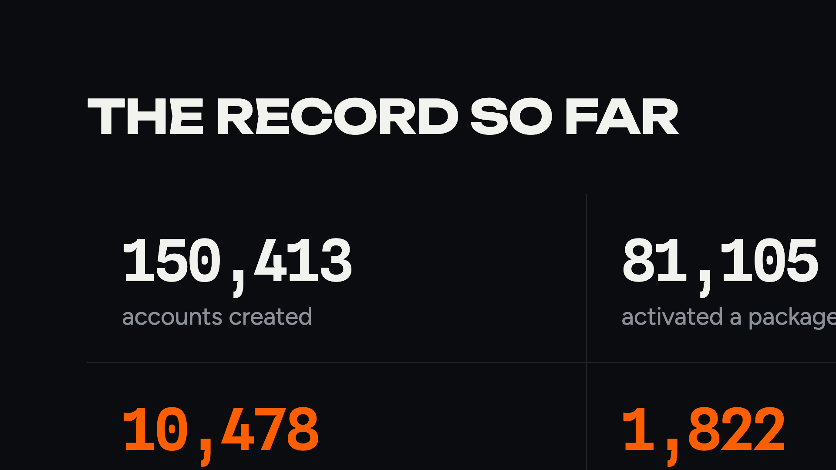
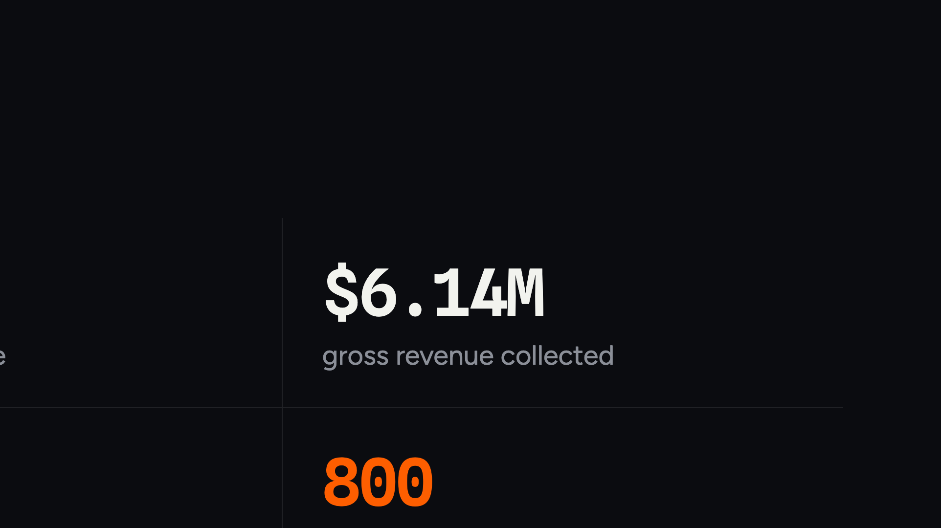
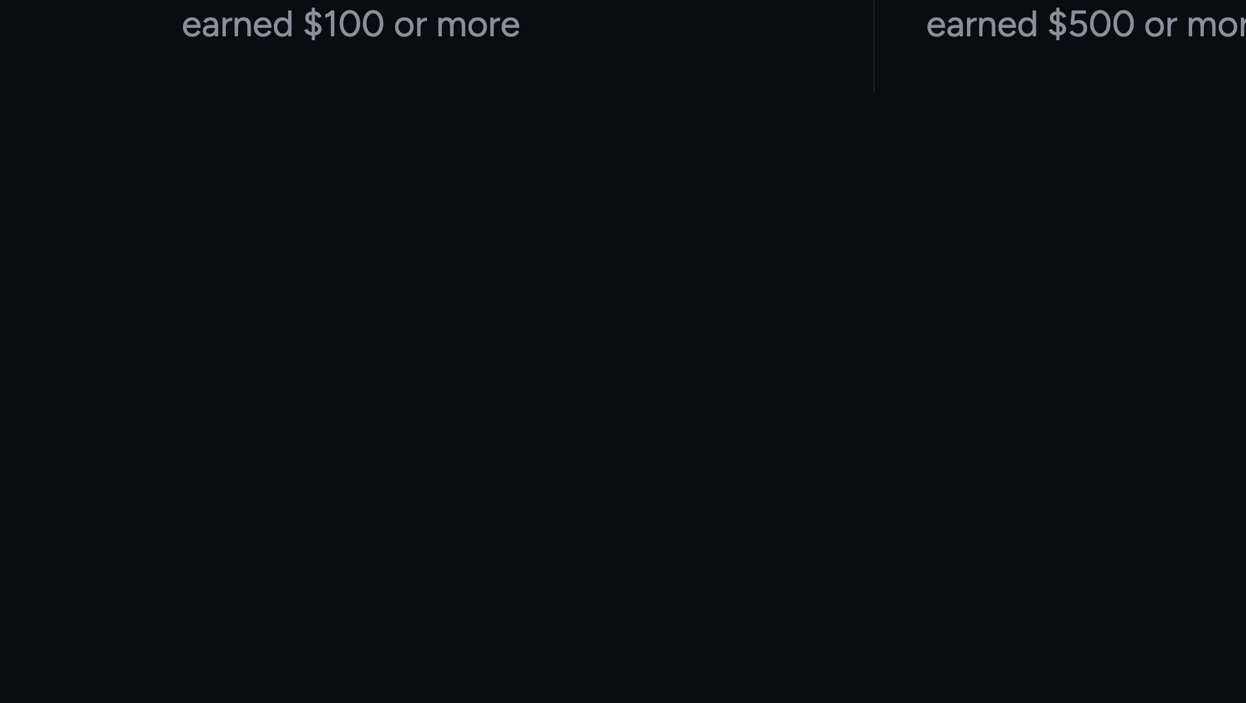
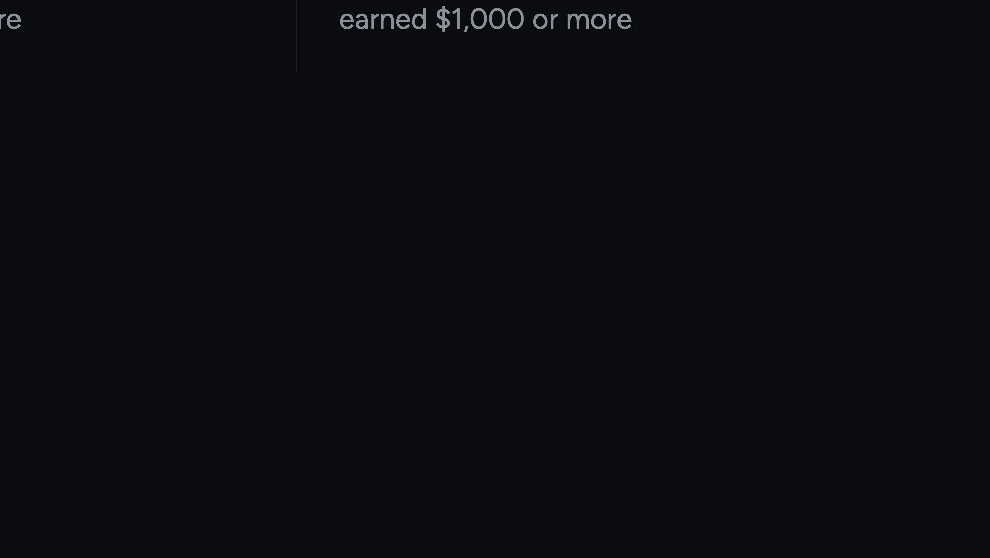
Notes:
Four numbers. Do not read them all — point at accounts and activations, let the audience read the rest.

Slide 5

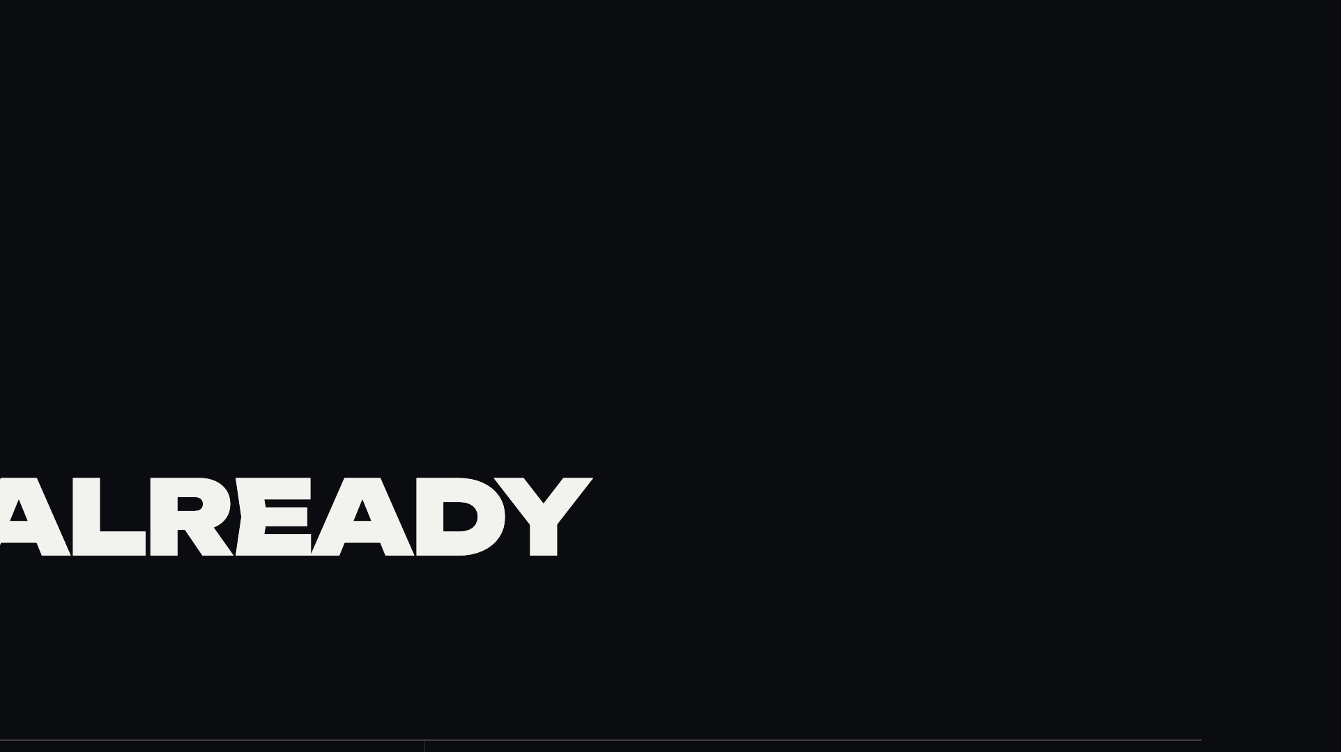
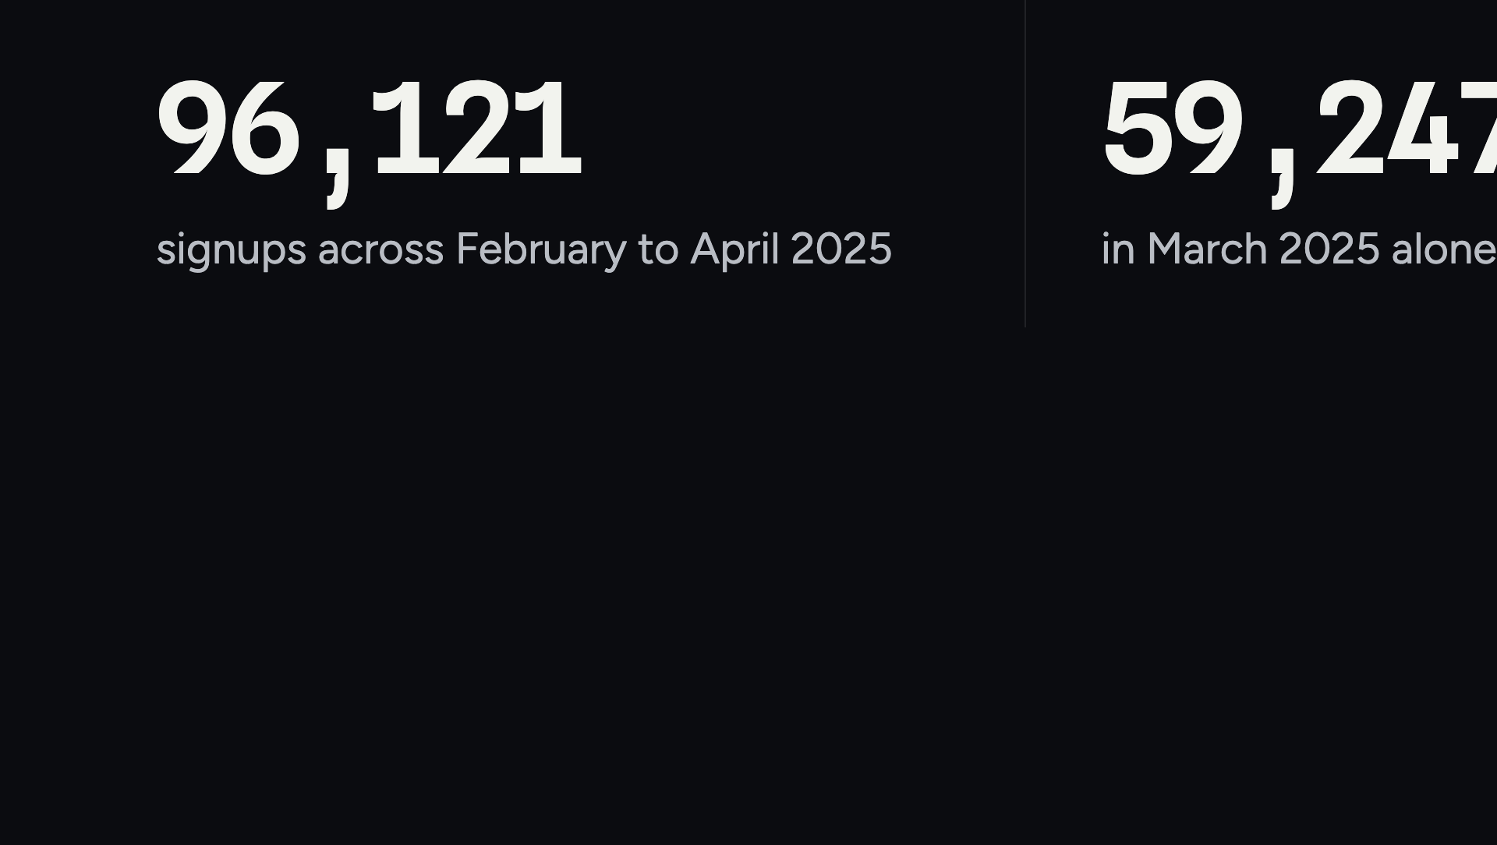
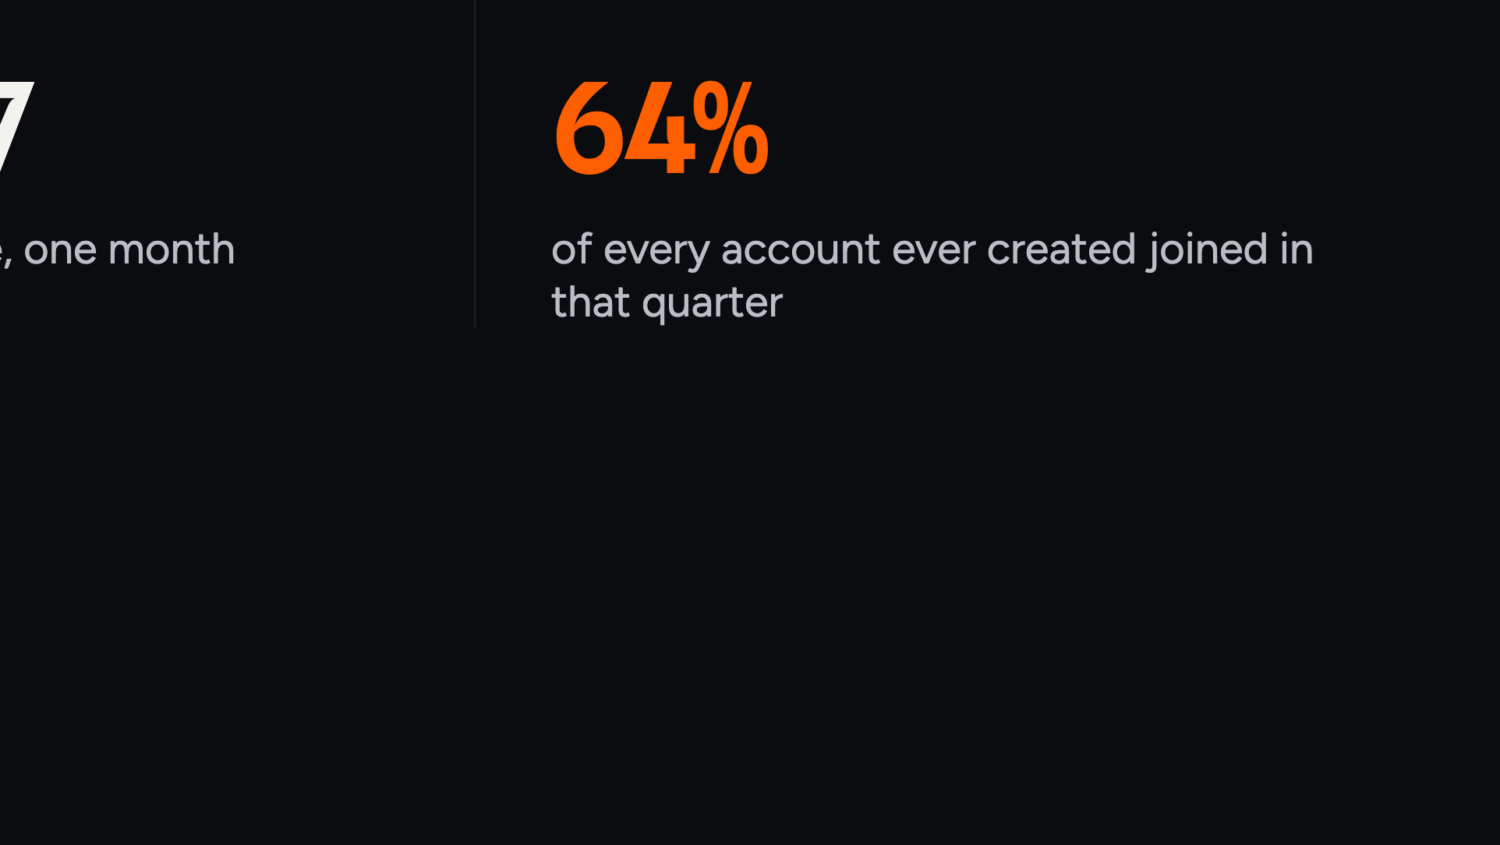
Notes:
The demand question is already answered. When the offer was right, 96,000 people joined in ninety days.

Slide 6

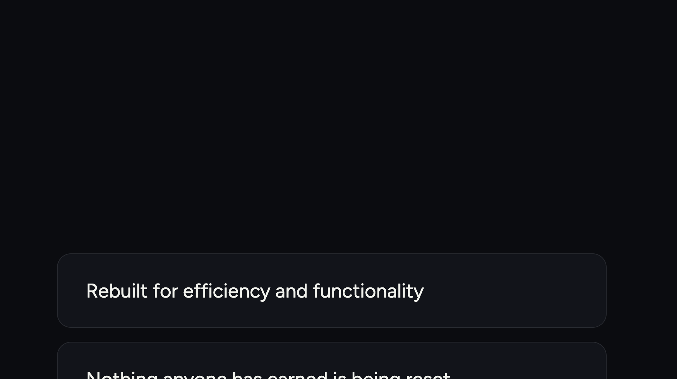
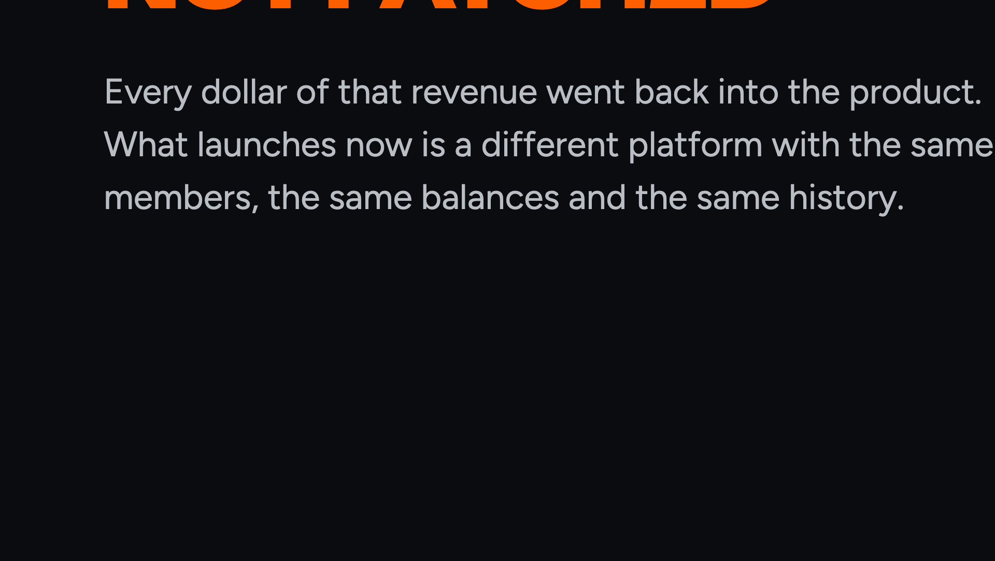
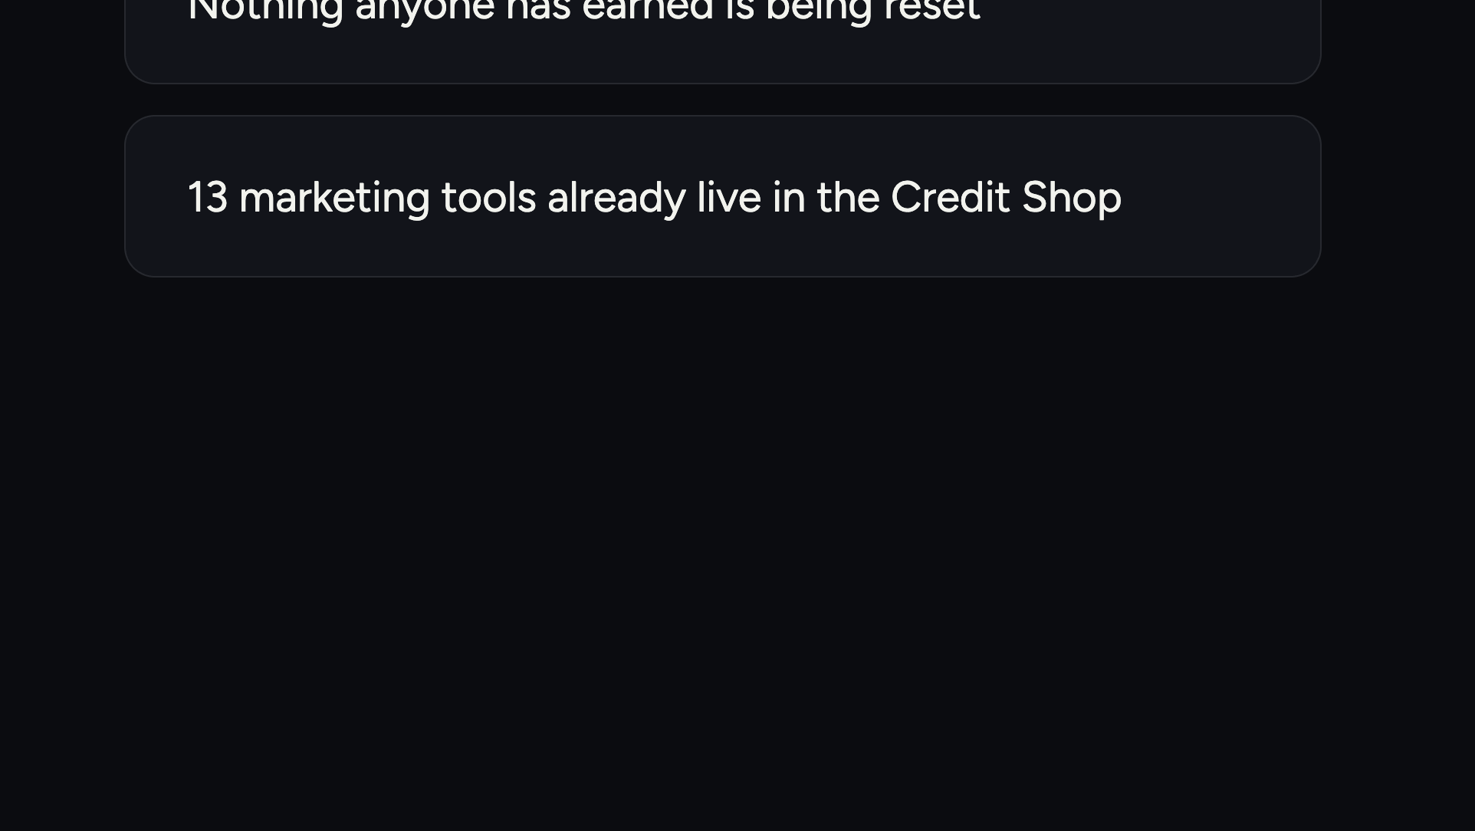
Notes:
Where the revenue went. The platform was rebuilt, not patched. Nothing anyone earned was reset.

Slide 7




Notes:
Section break. Product before money.

Slide 8
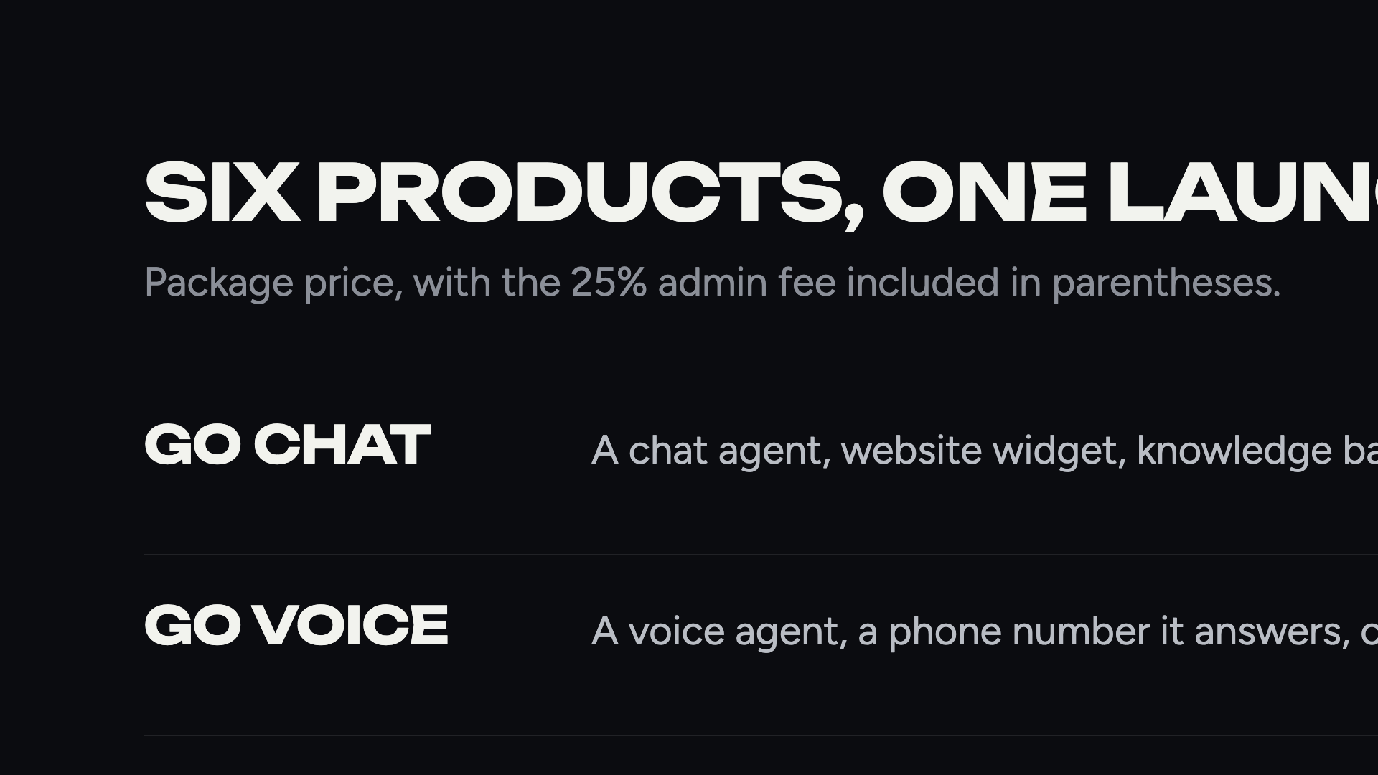
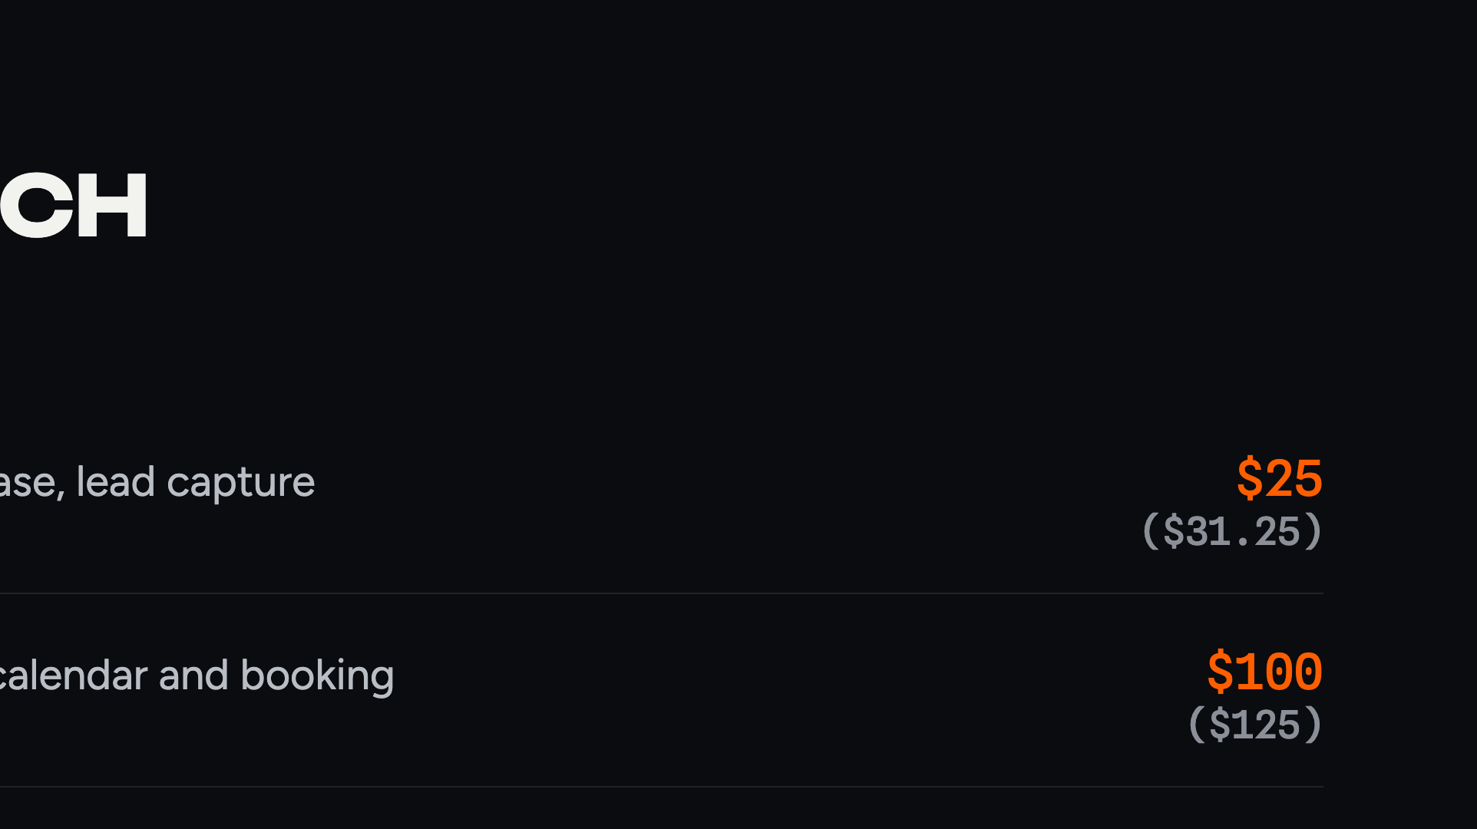
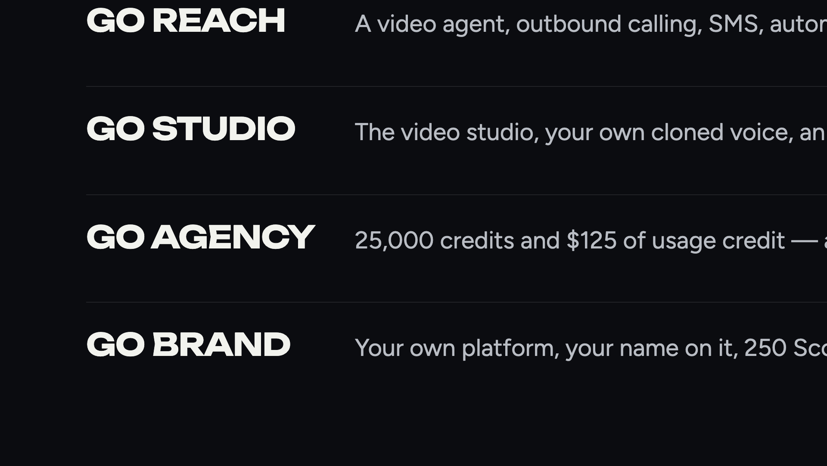
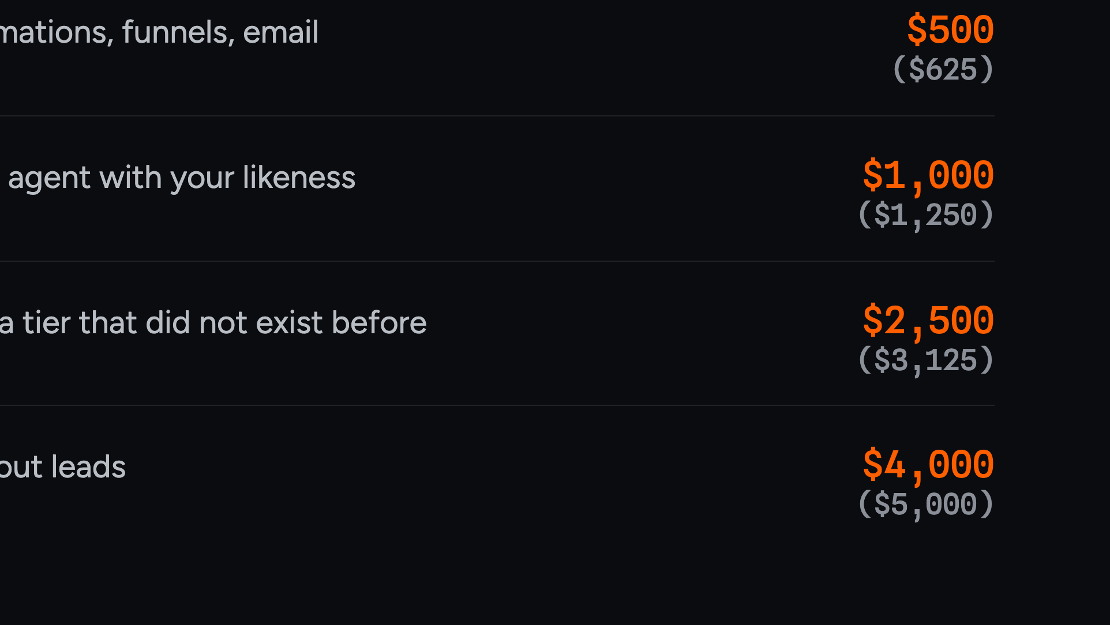
Notes:
Read the product names, not the feature lists. The audience reads faster than you talk.

Slide 9
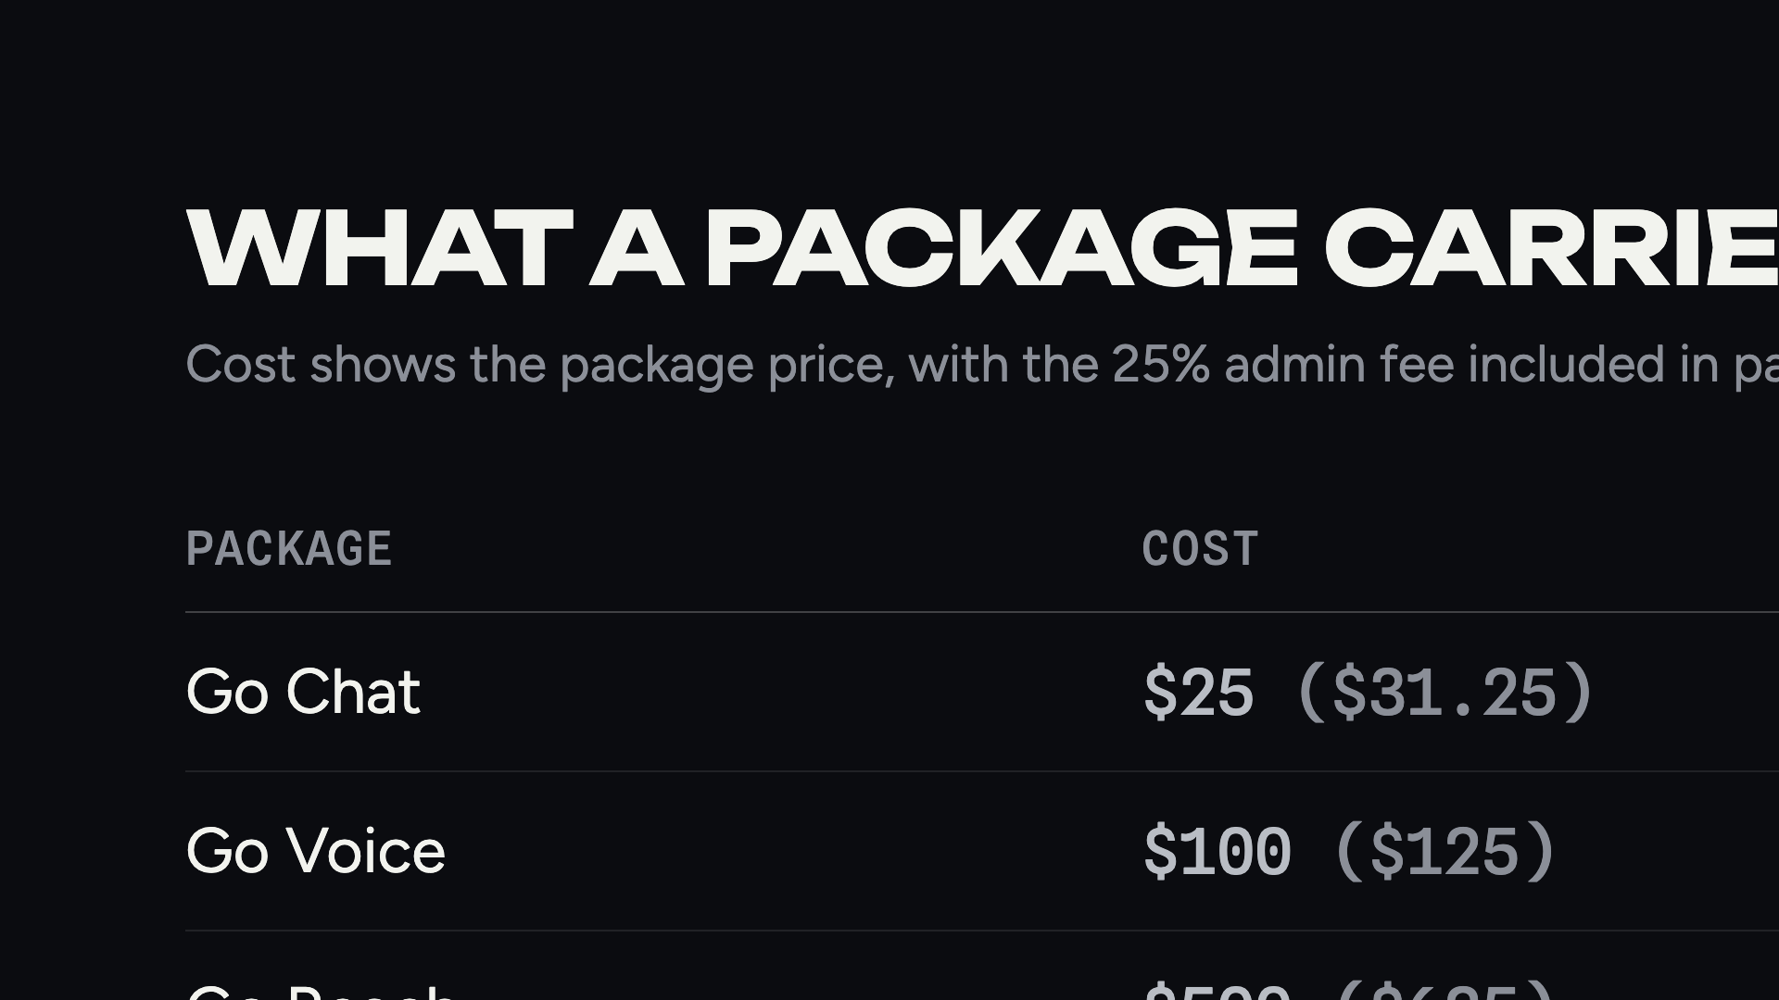
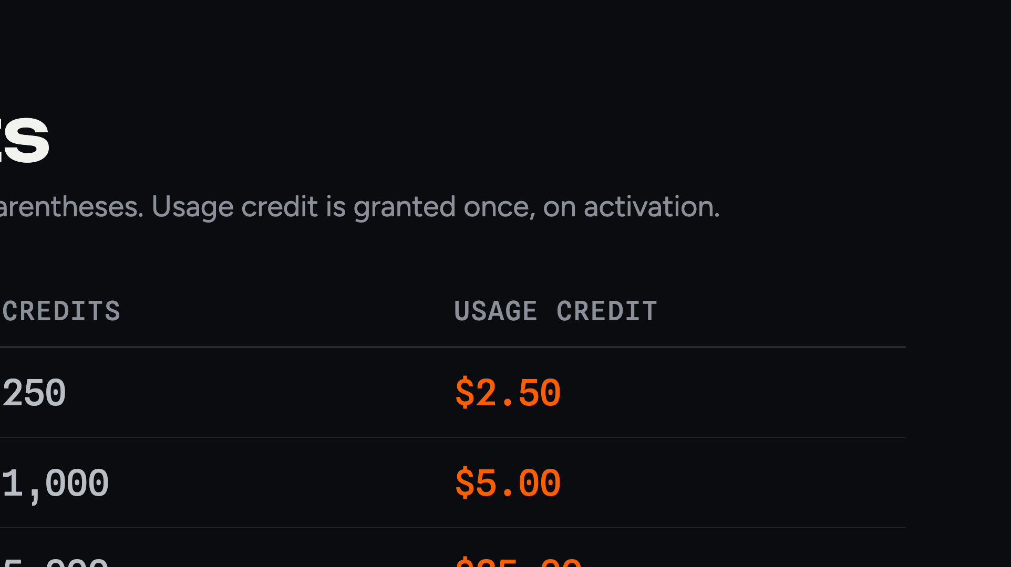
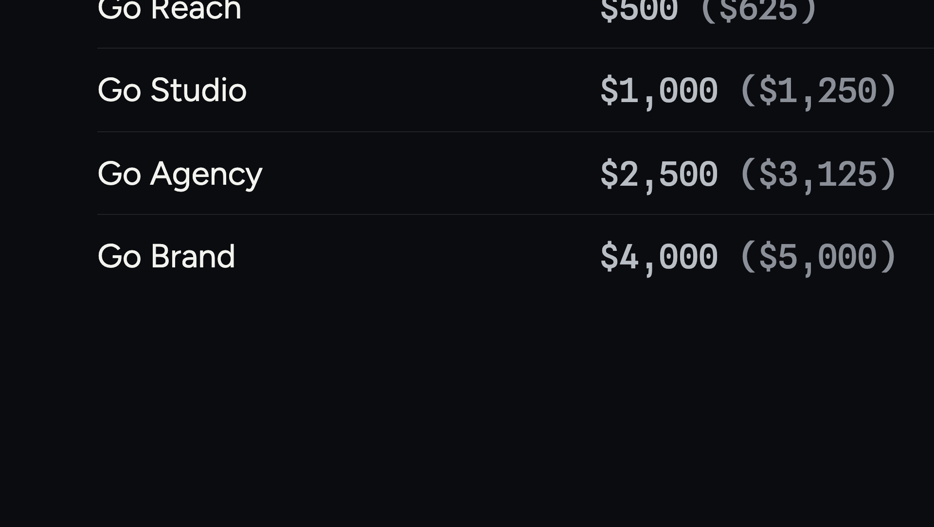
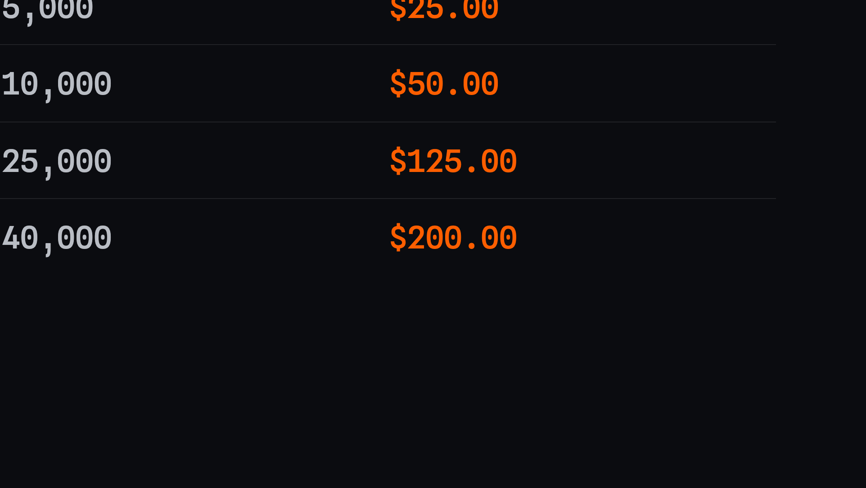
Notes:
Every package carries credits and a one-time usage credit. Credits are how the tools get paid for.

Slide 10

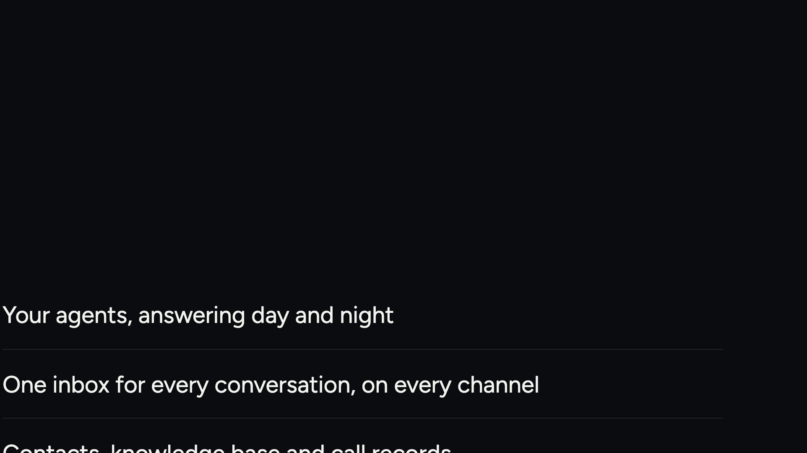
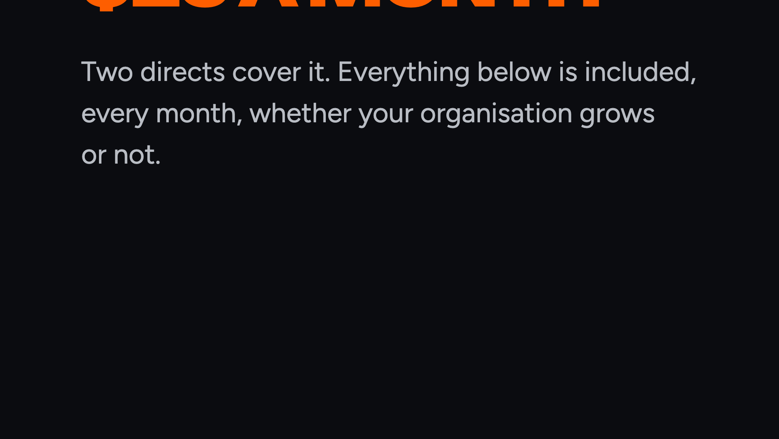
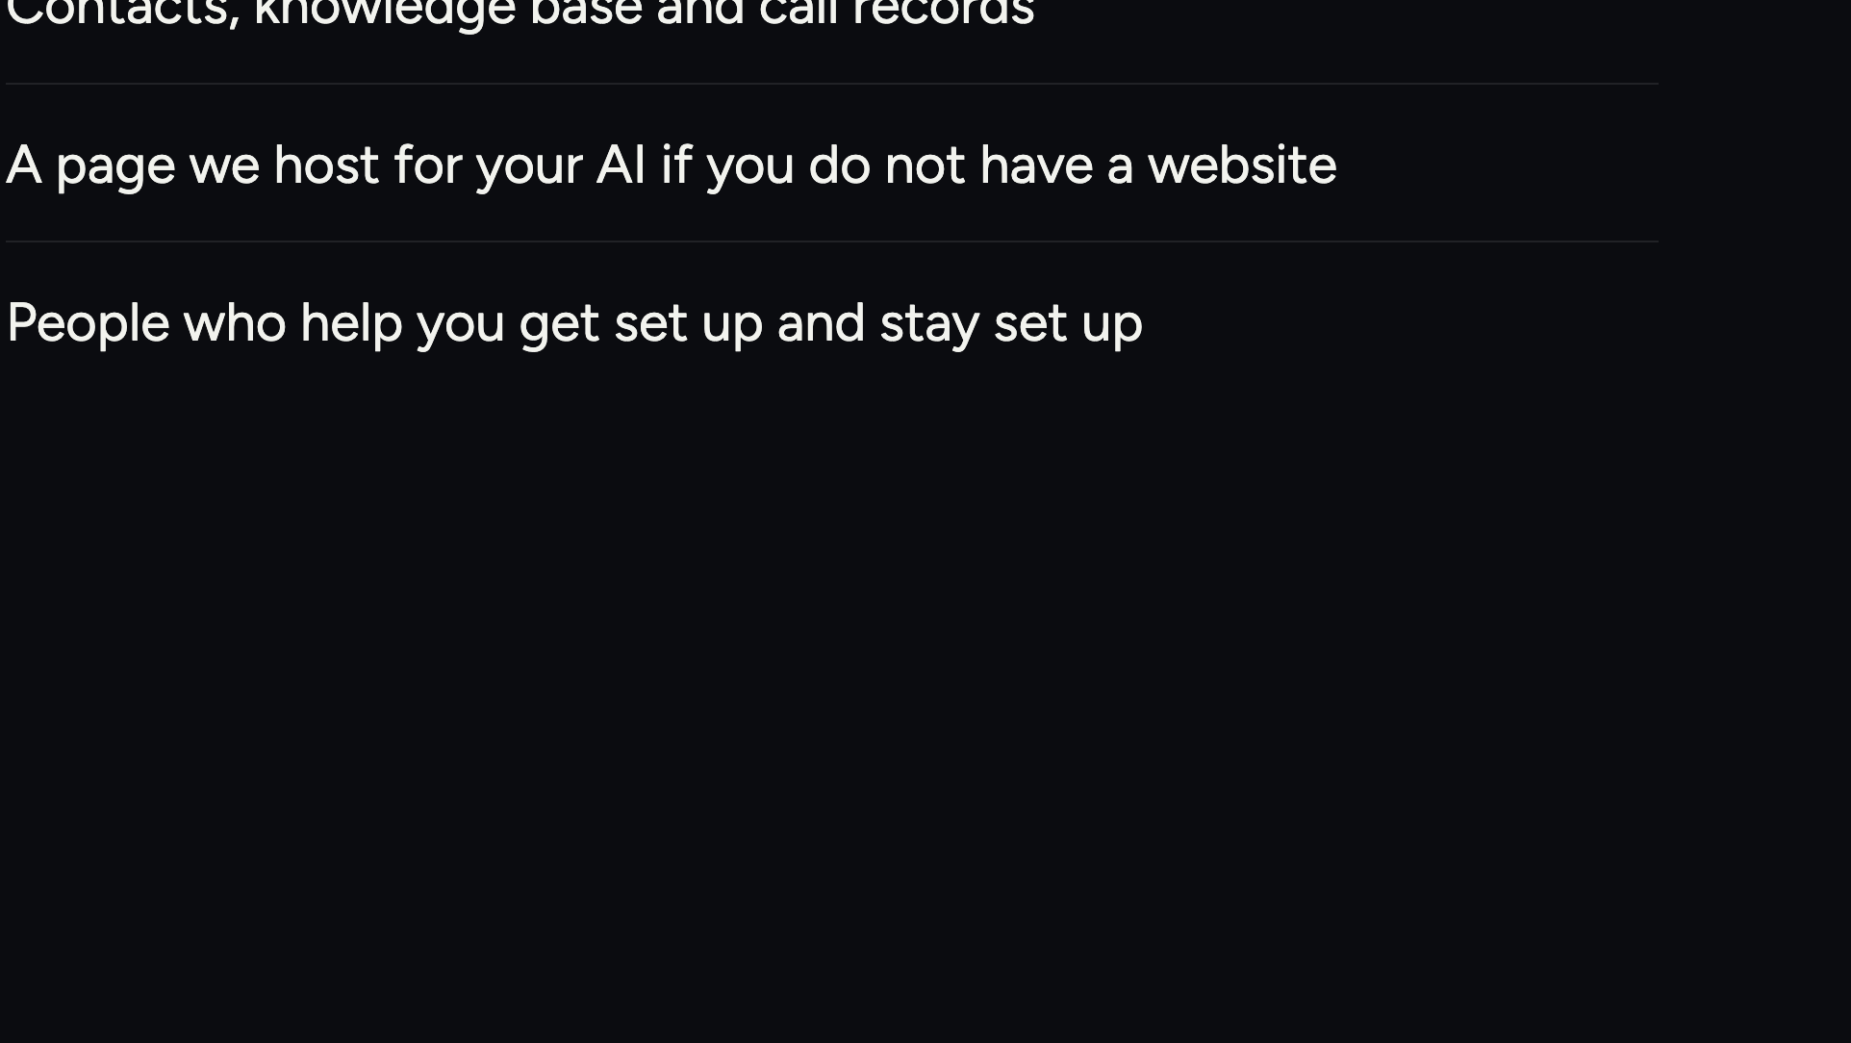
Notes:
This is the recurring product. Twenty-five dollars a month, and it is worth the money on its own.

Slide 11
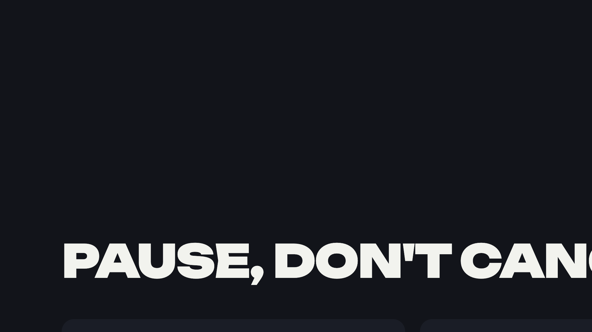
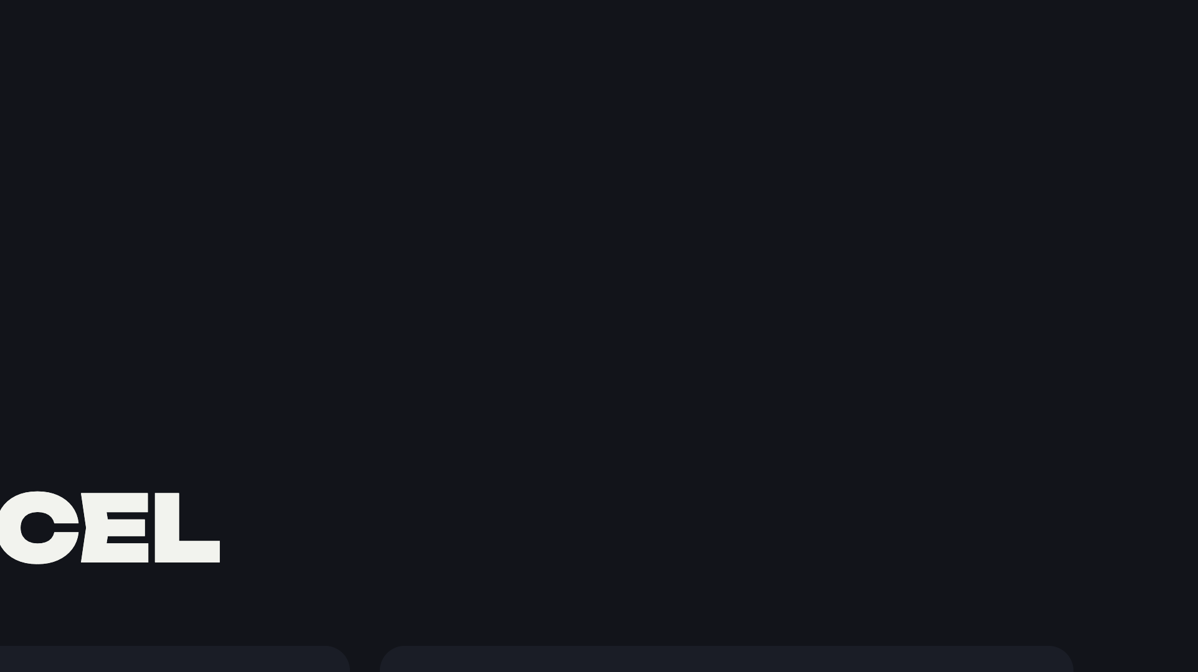
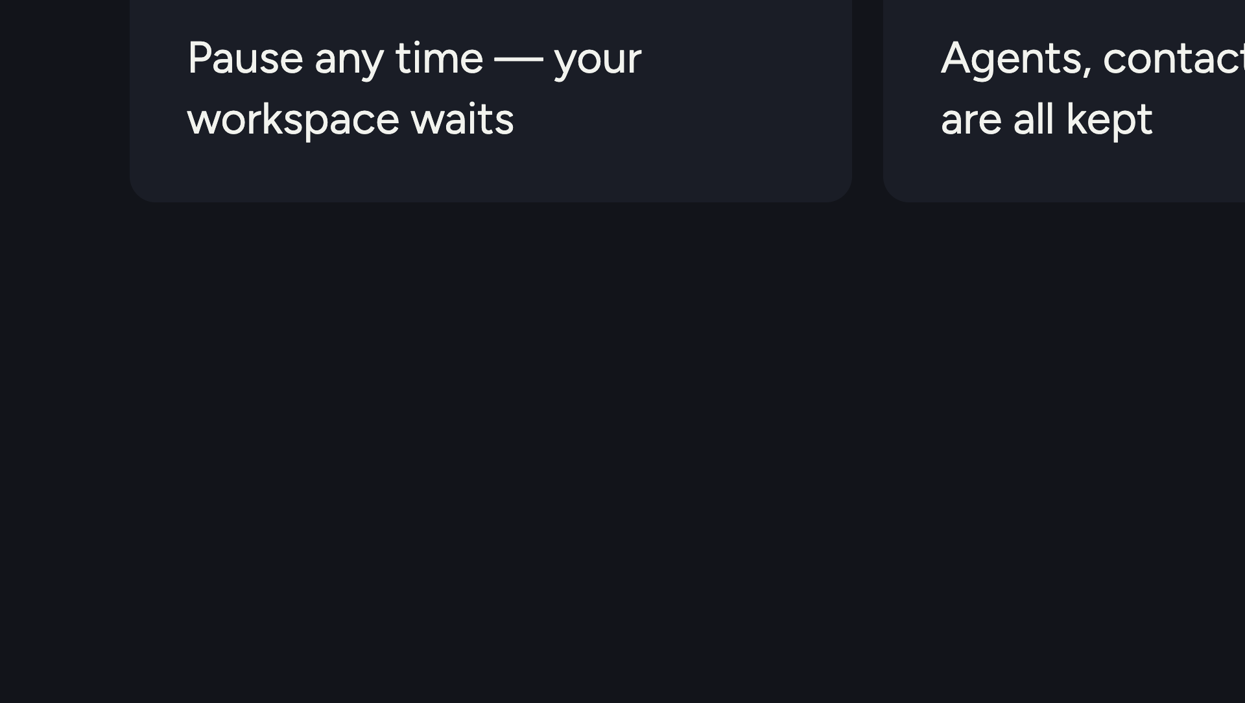
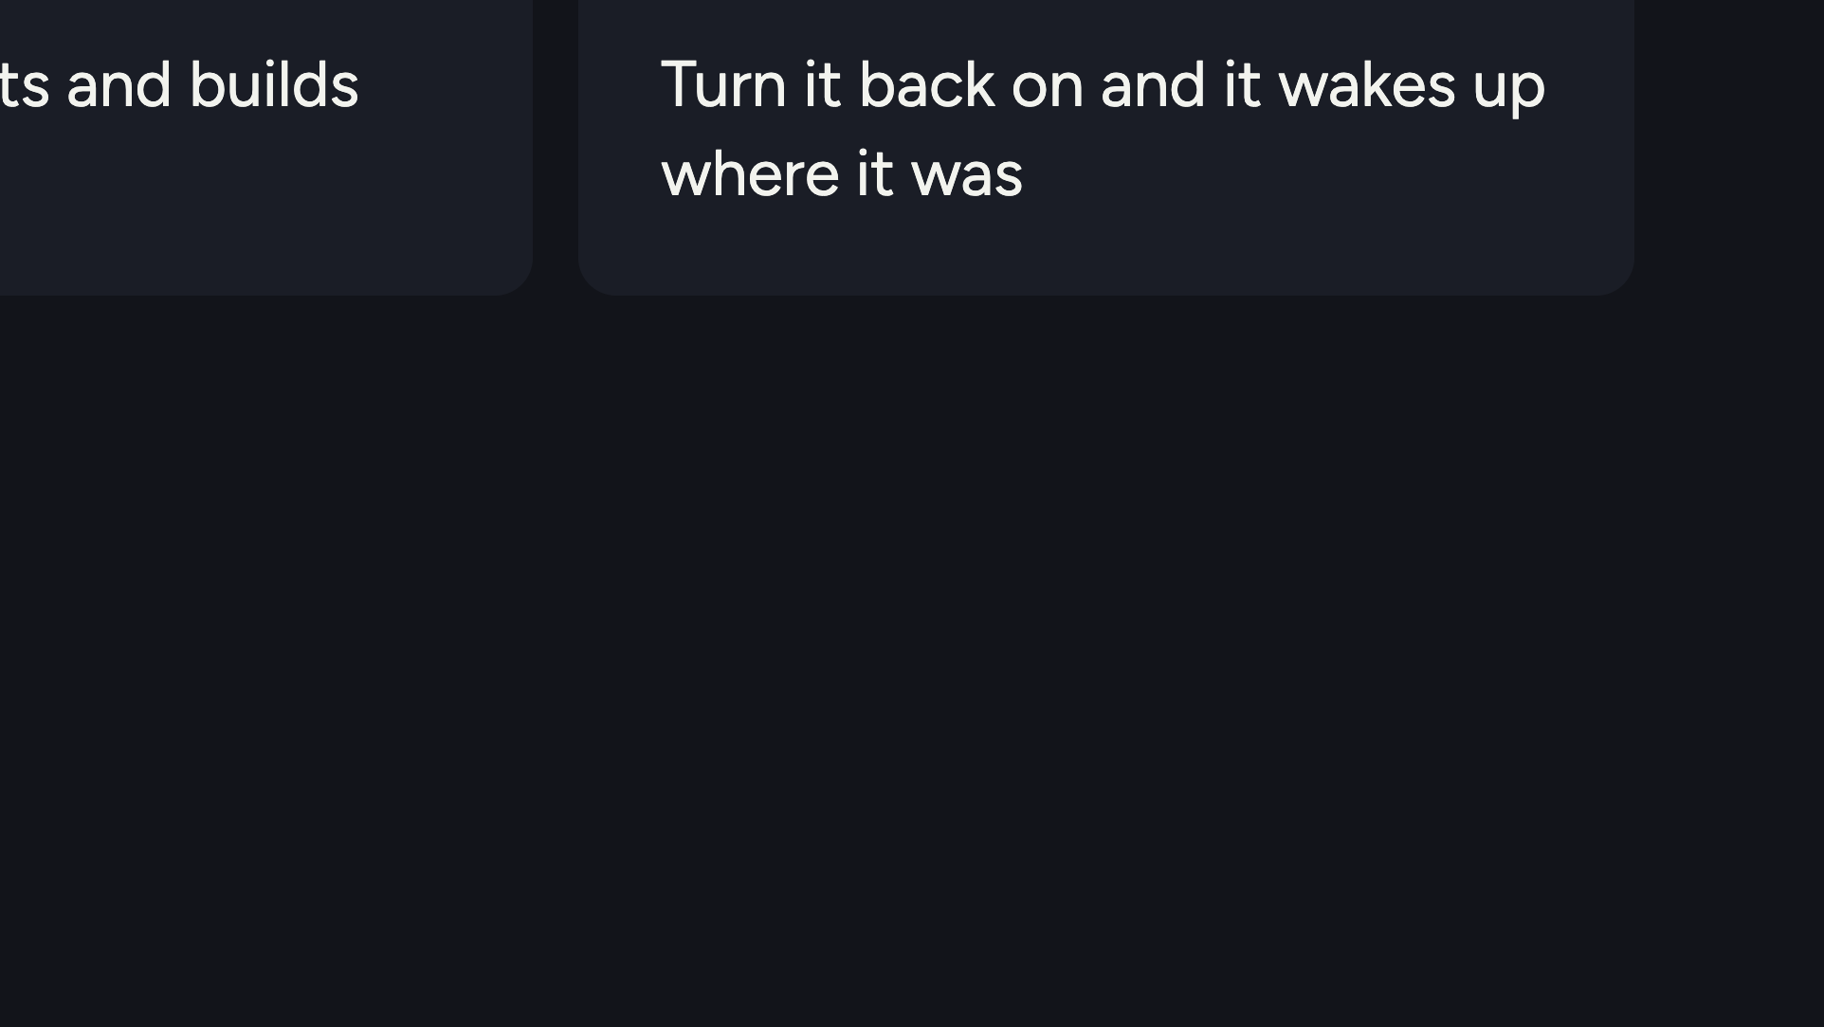
Notes:
Removes the biggest objection to a subscription. Nothing is lost when life happens.

Slide 12
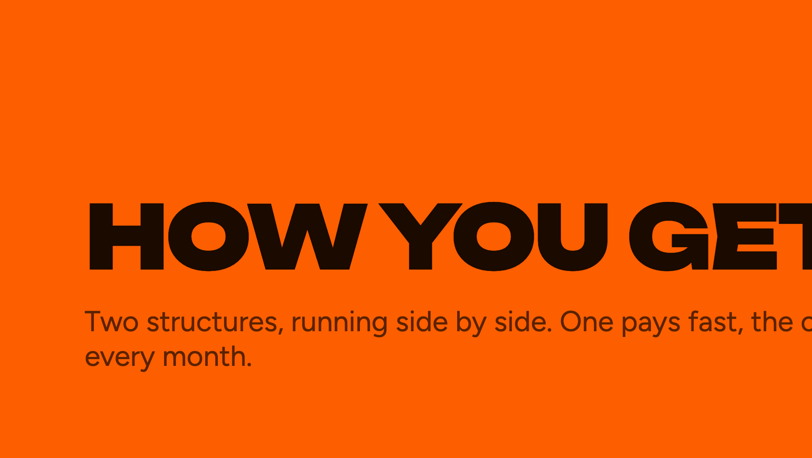

Notes:
Section break. Now the money.

Slide 13
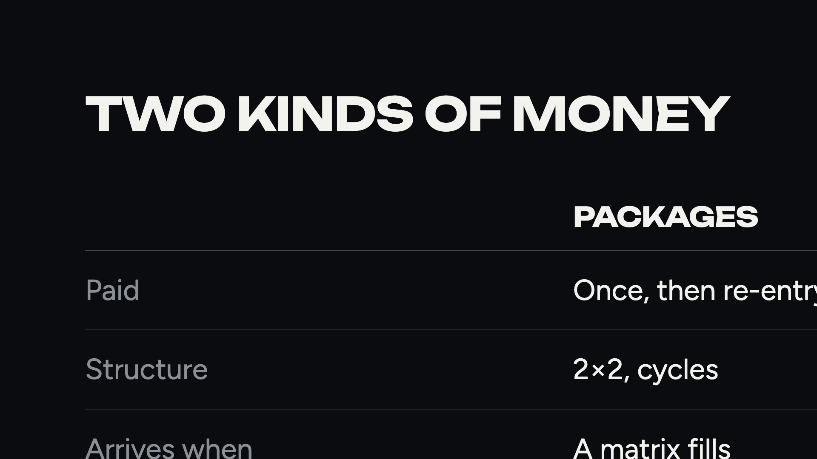
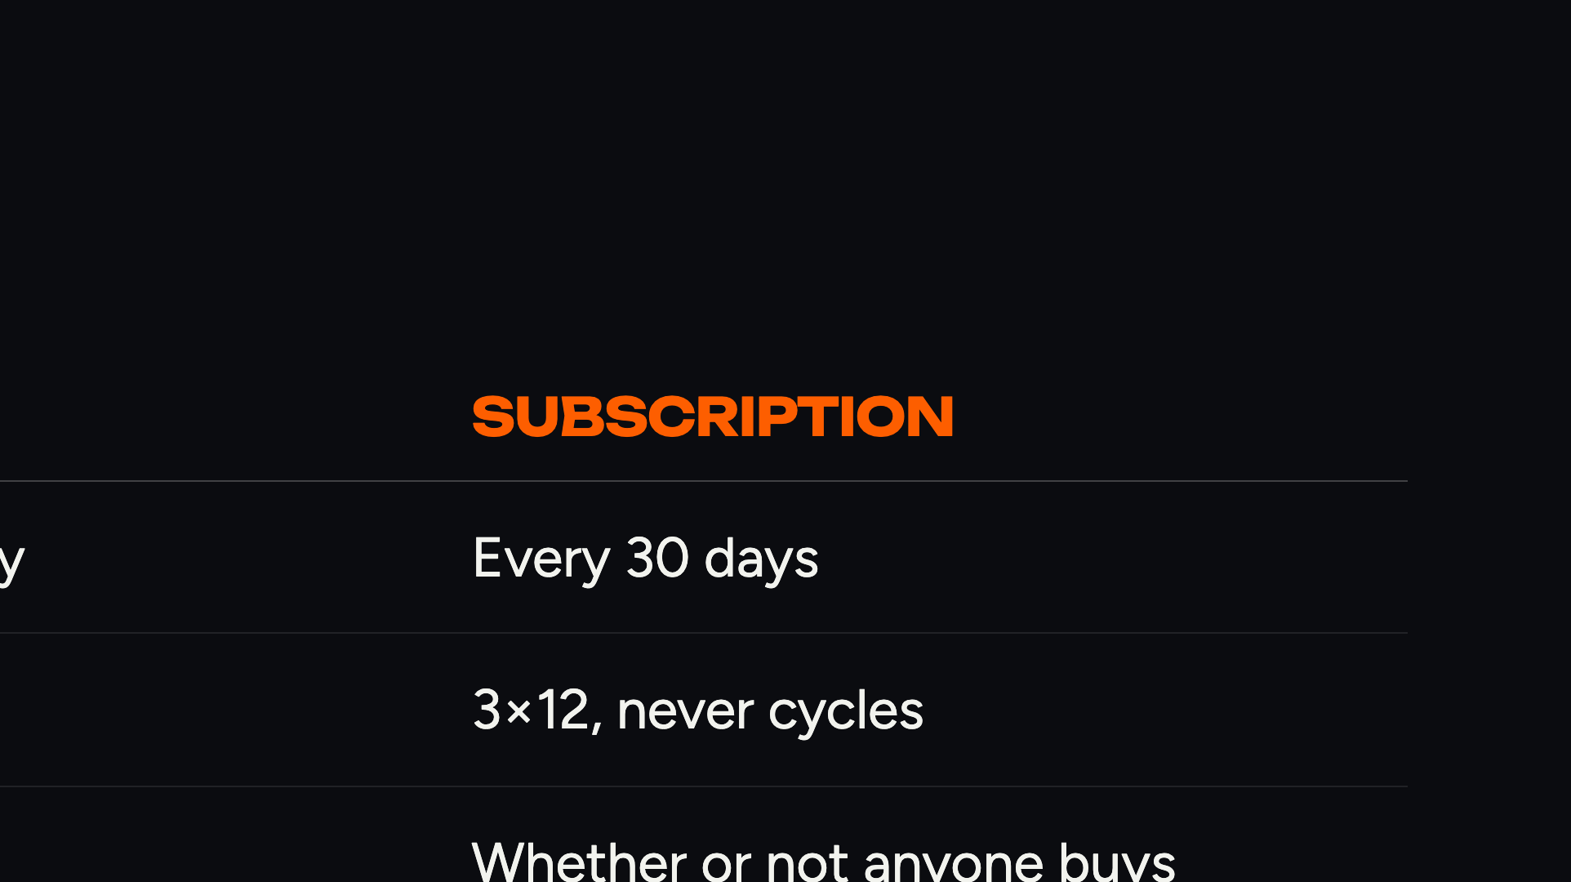
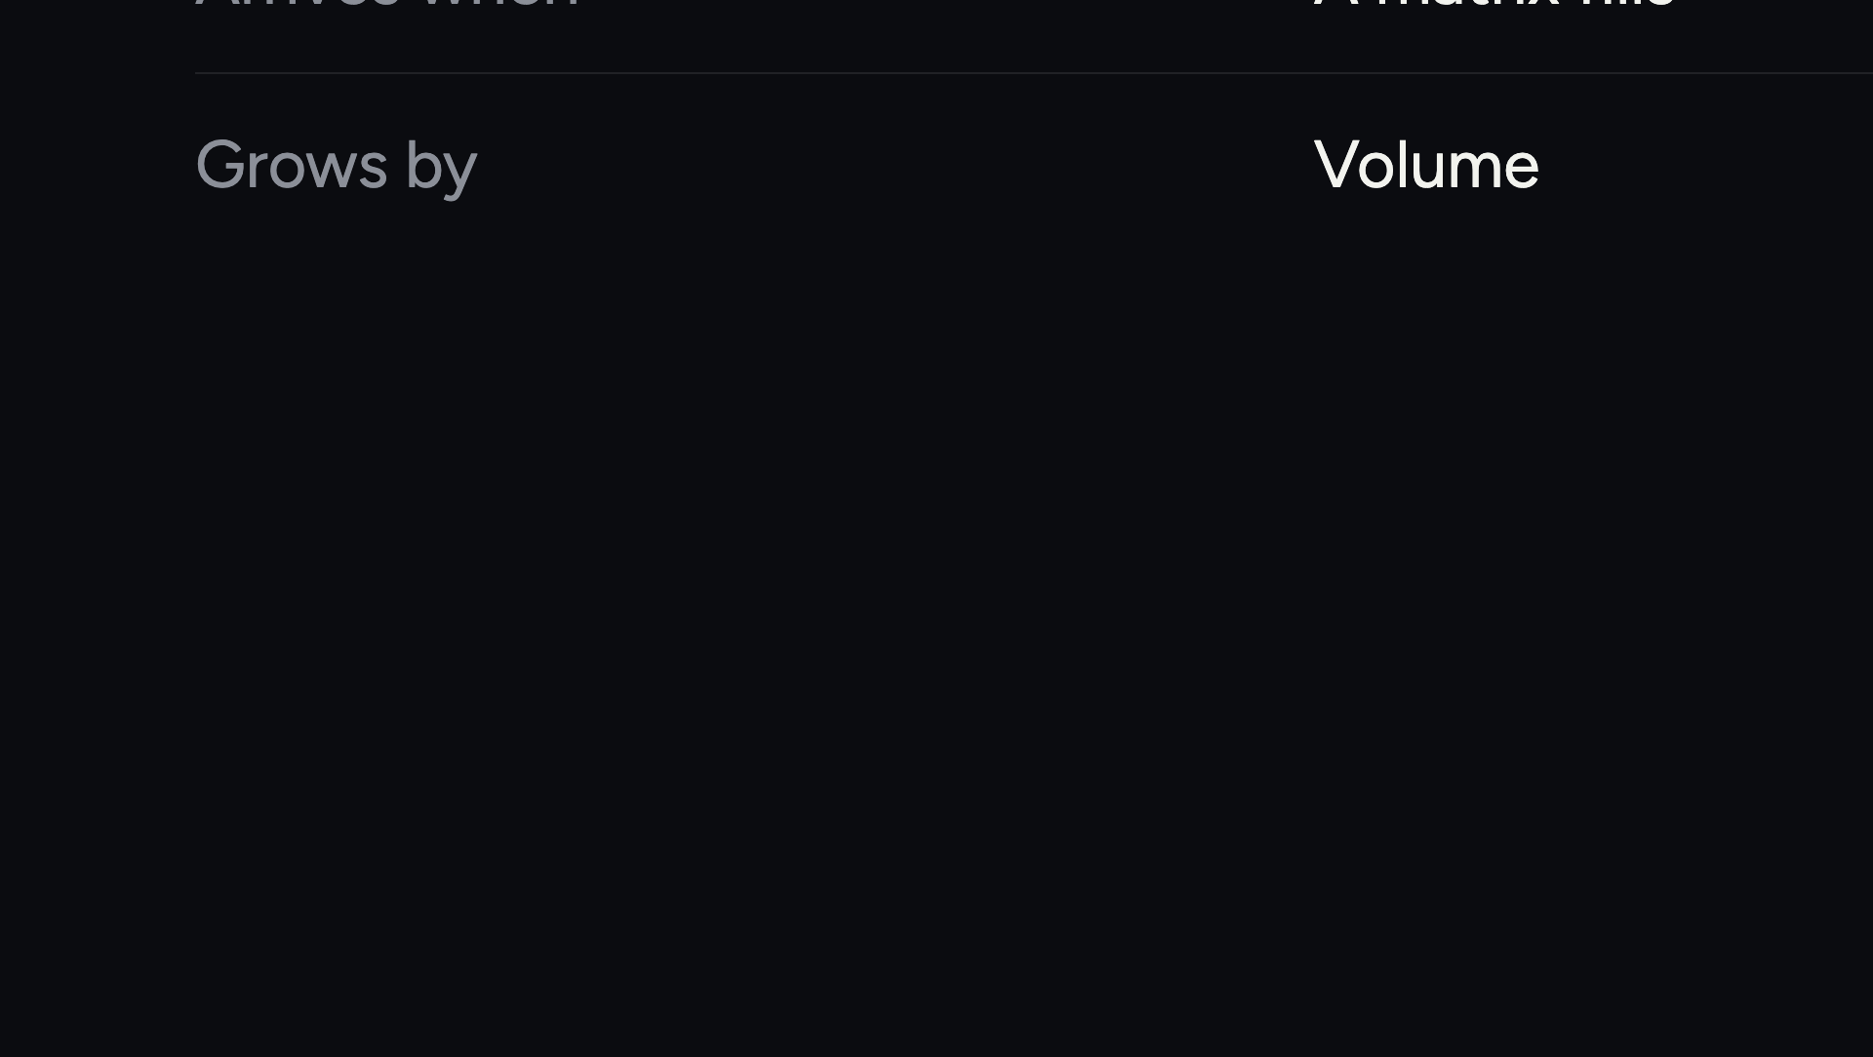
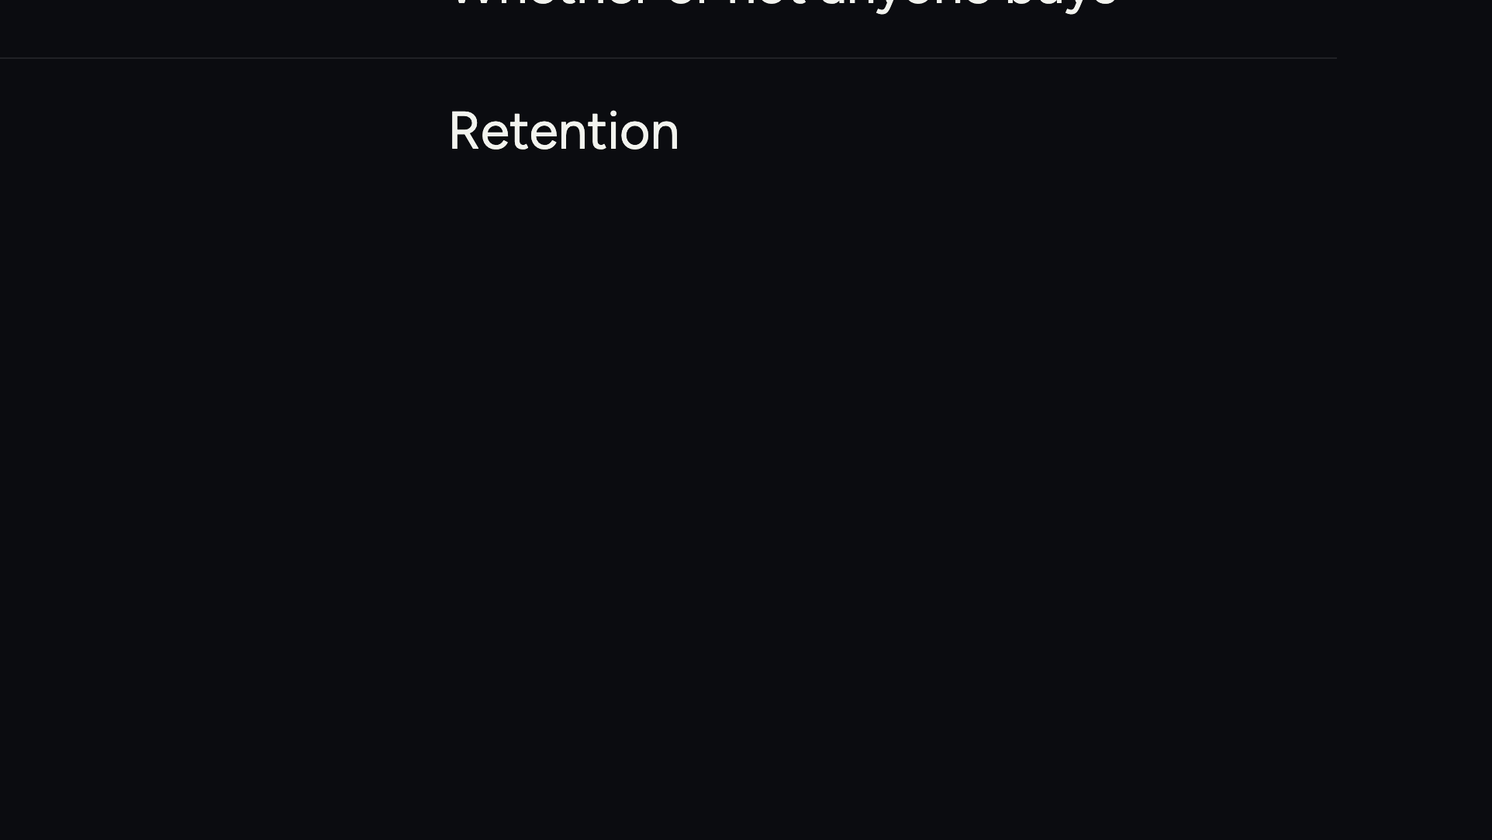
Notes:
The spine of the whole plan. Packages and subscription are different machines with different fuel.

Slide 14
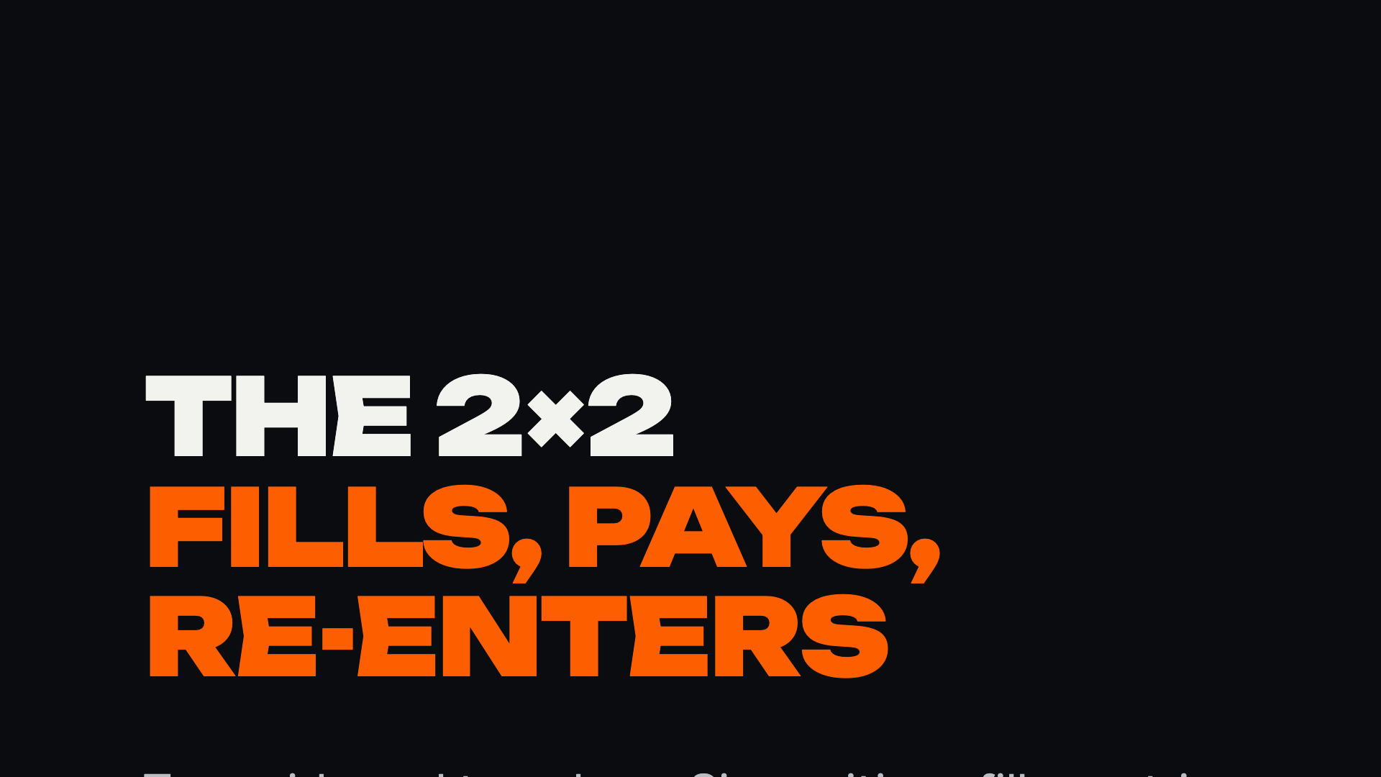
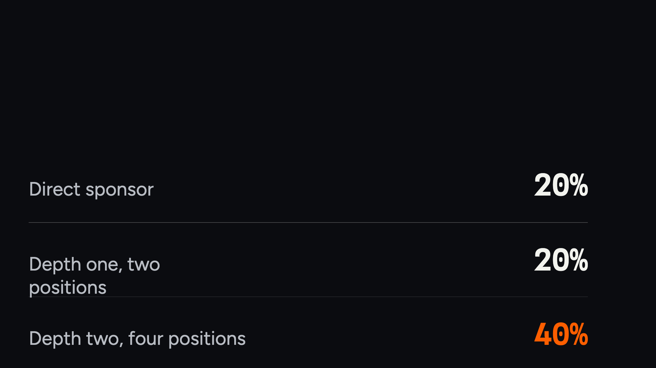
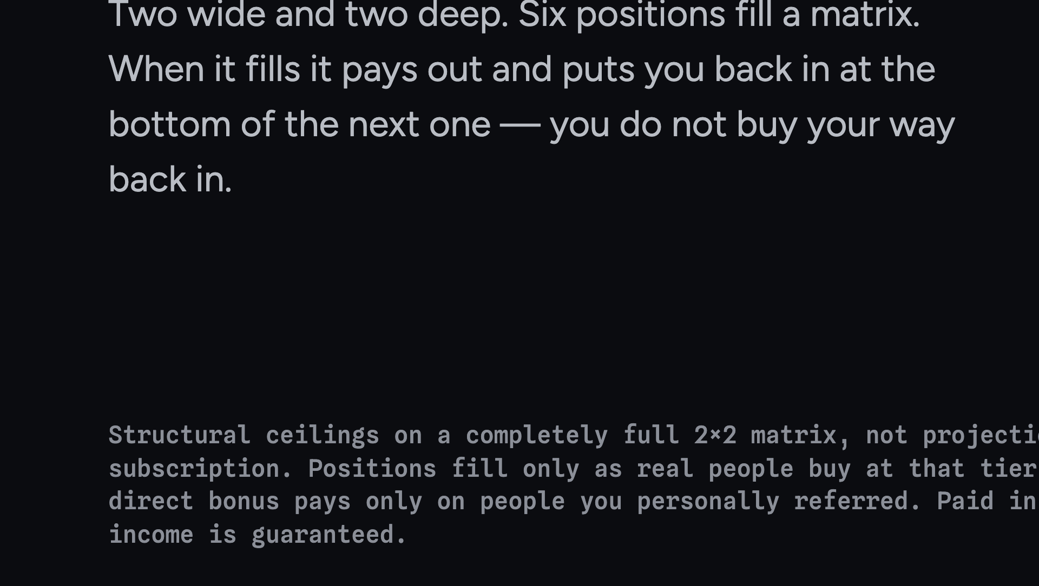
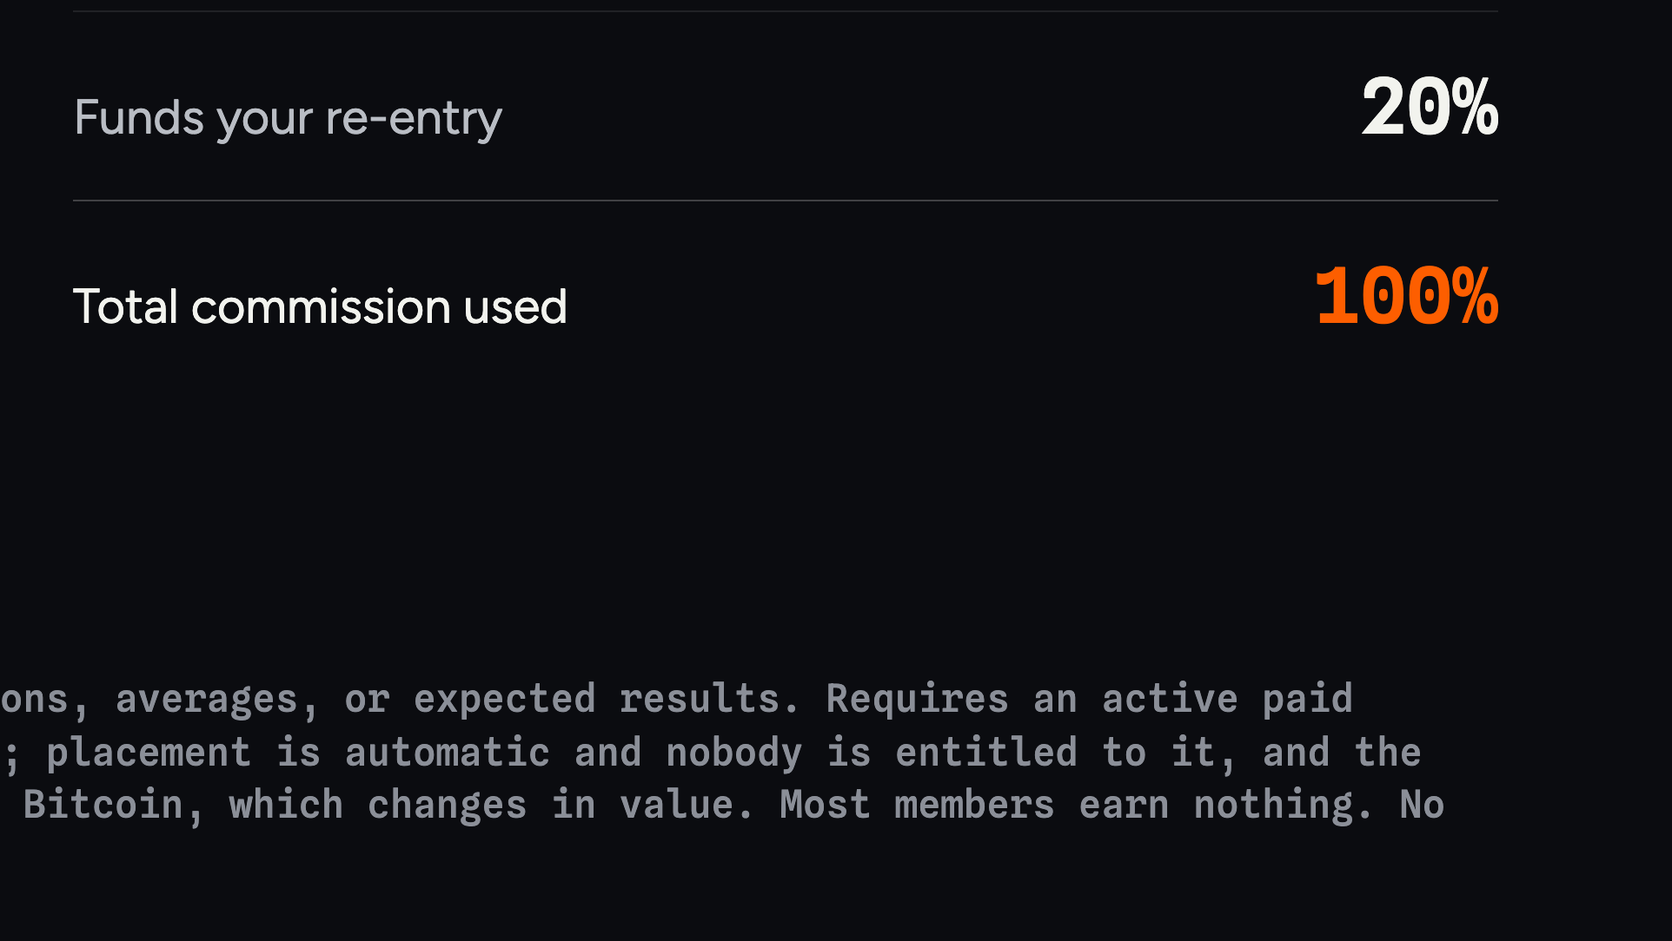
Notes:
Six positions fill a matrix. Twenty per cent to the sponsor, twenty at depth one, forty at depth two, and the last twenty buys your way back in.

Slide 15
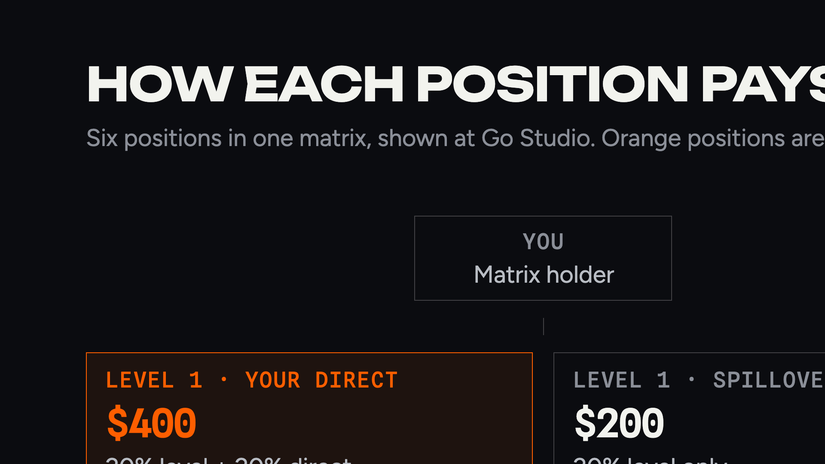
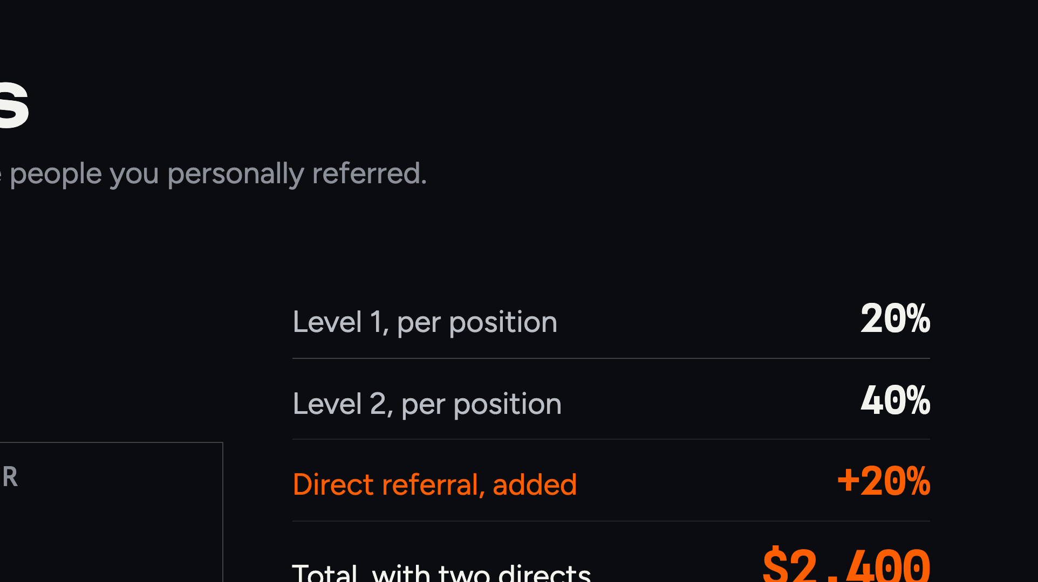
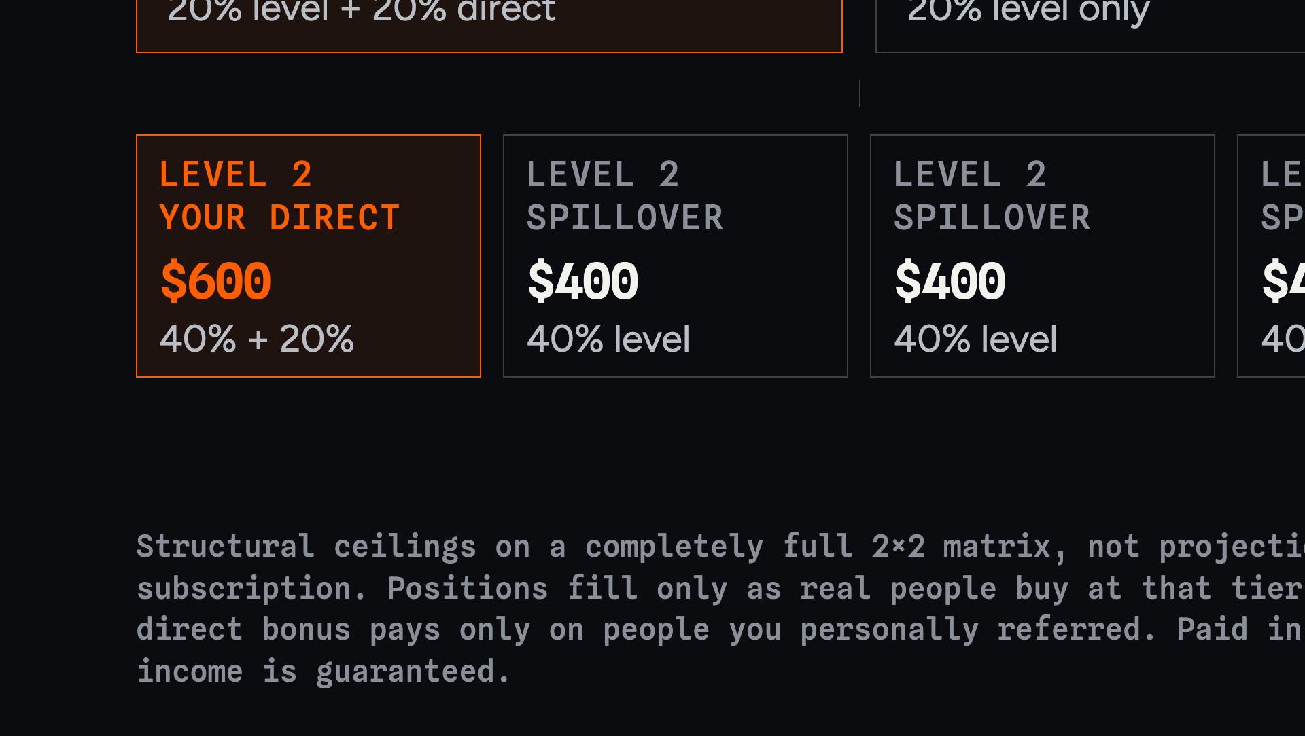
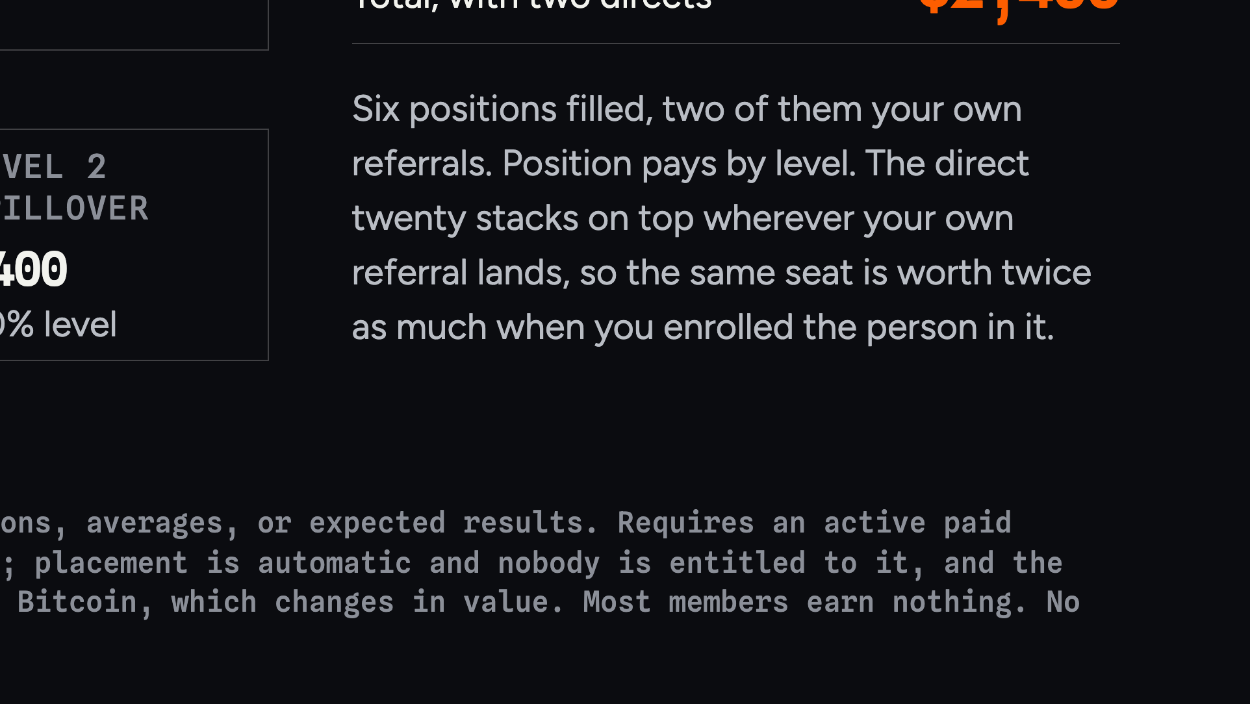
Notes:
Walk the diagram. Every position under you pays — twenty per cent at level one, forty at level two. The difference is who enrolled them: if you personally referred that person, you also take the direct twenty, so a direct at level one pays forty and a direct at level two pays sixty. Spillover still pays, it just pays the level rate only.

Slide 16
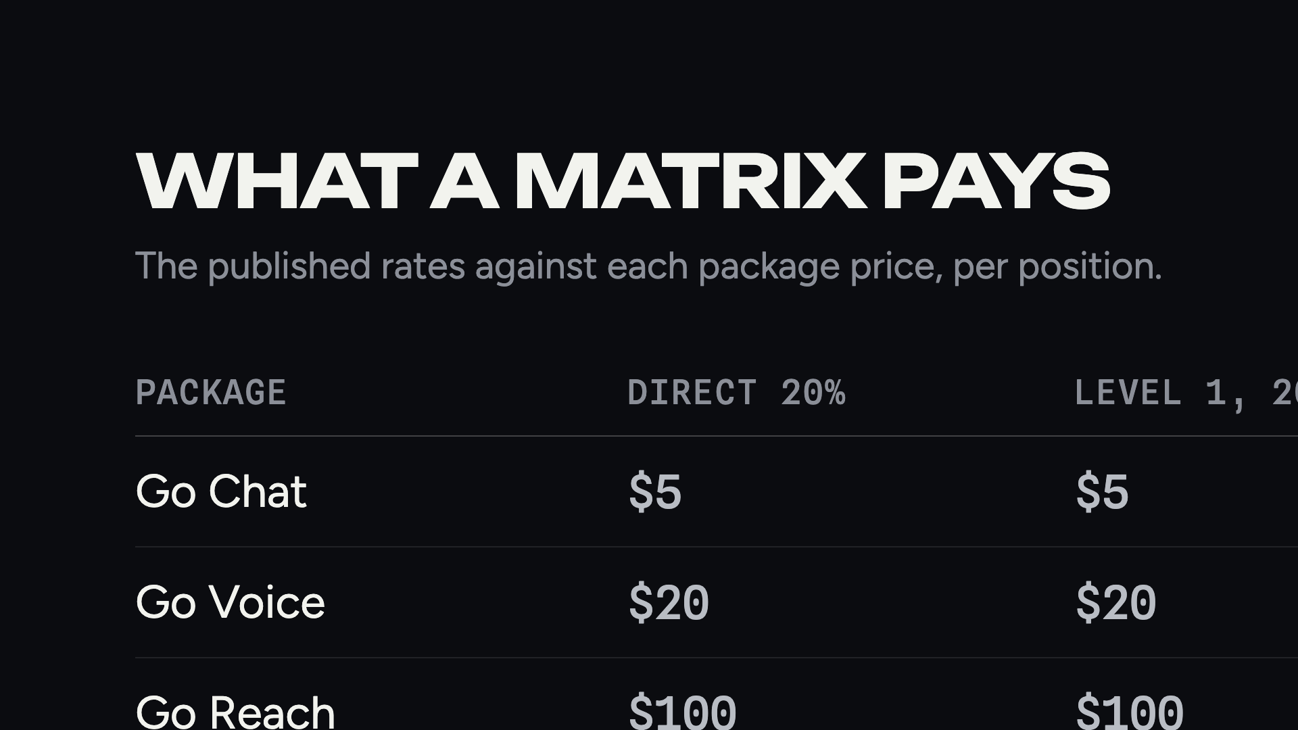
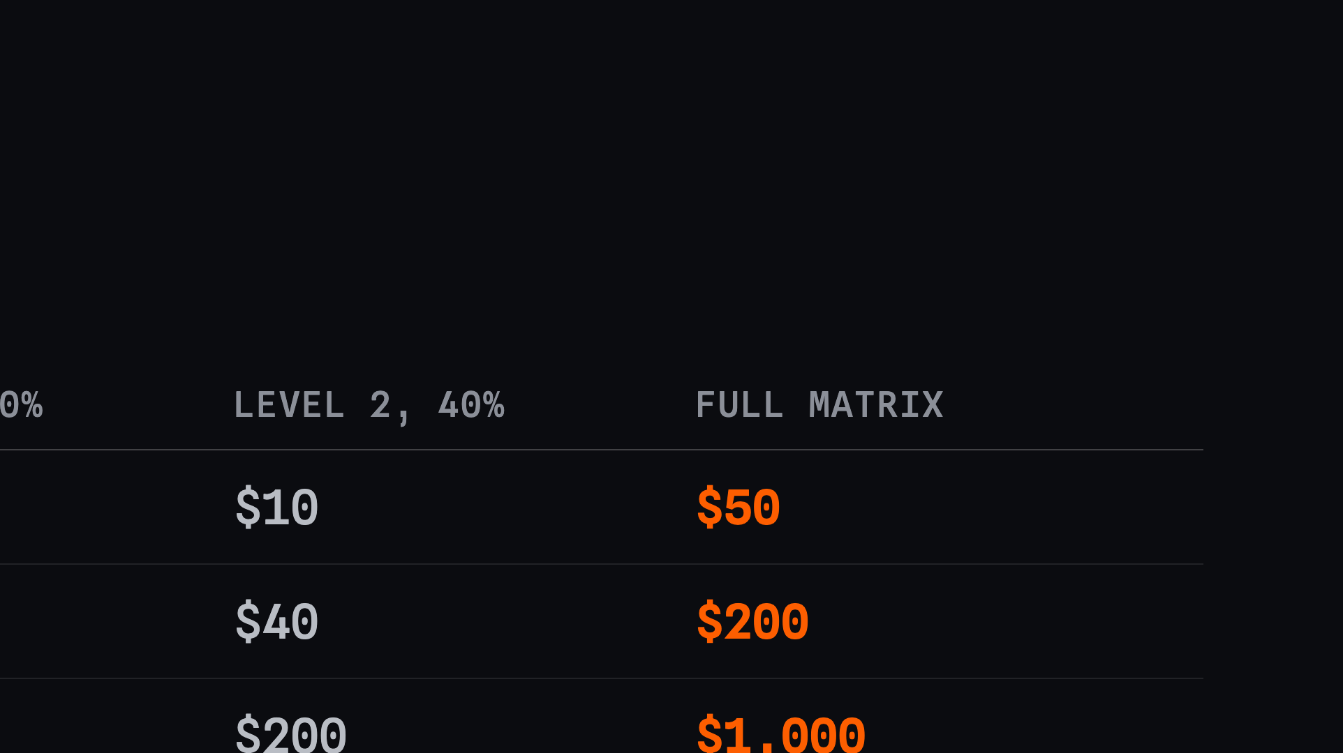
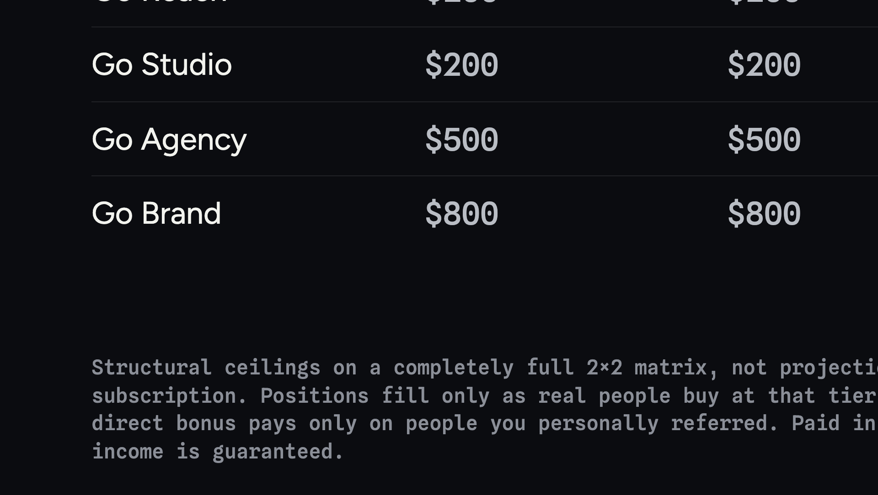
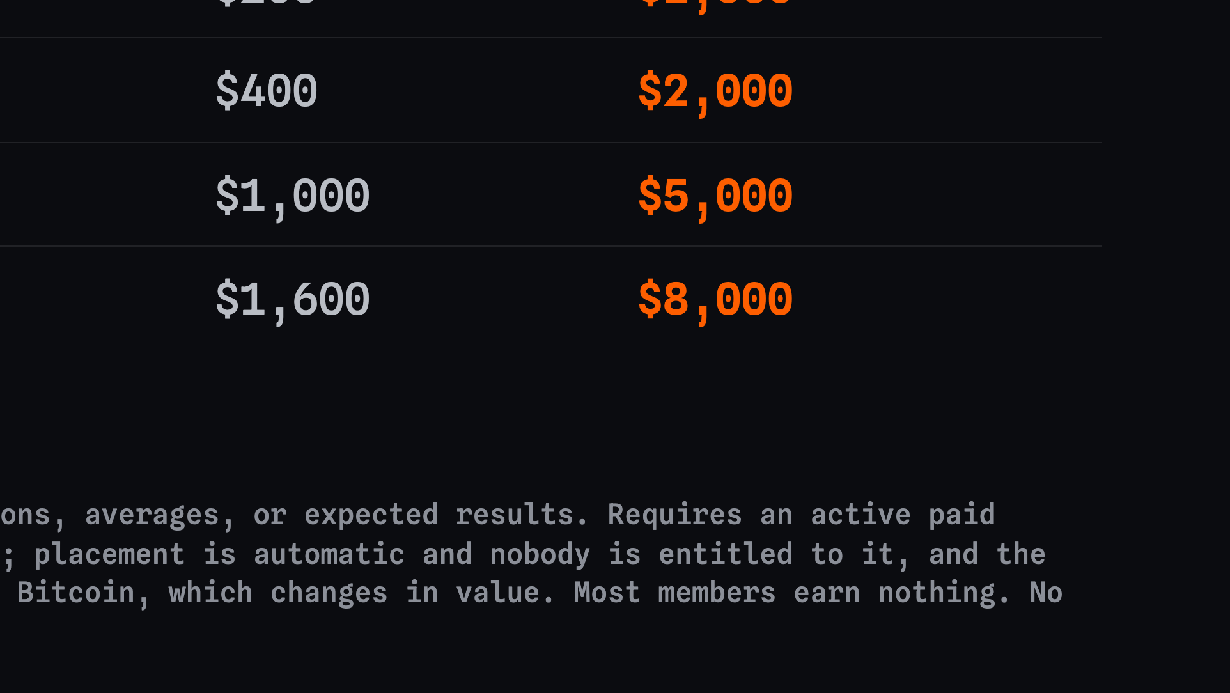
Notes:
The same percentages against the real package prices. This is why the packages pay fast — the dollars are large per position.

Slide 17
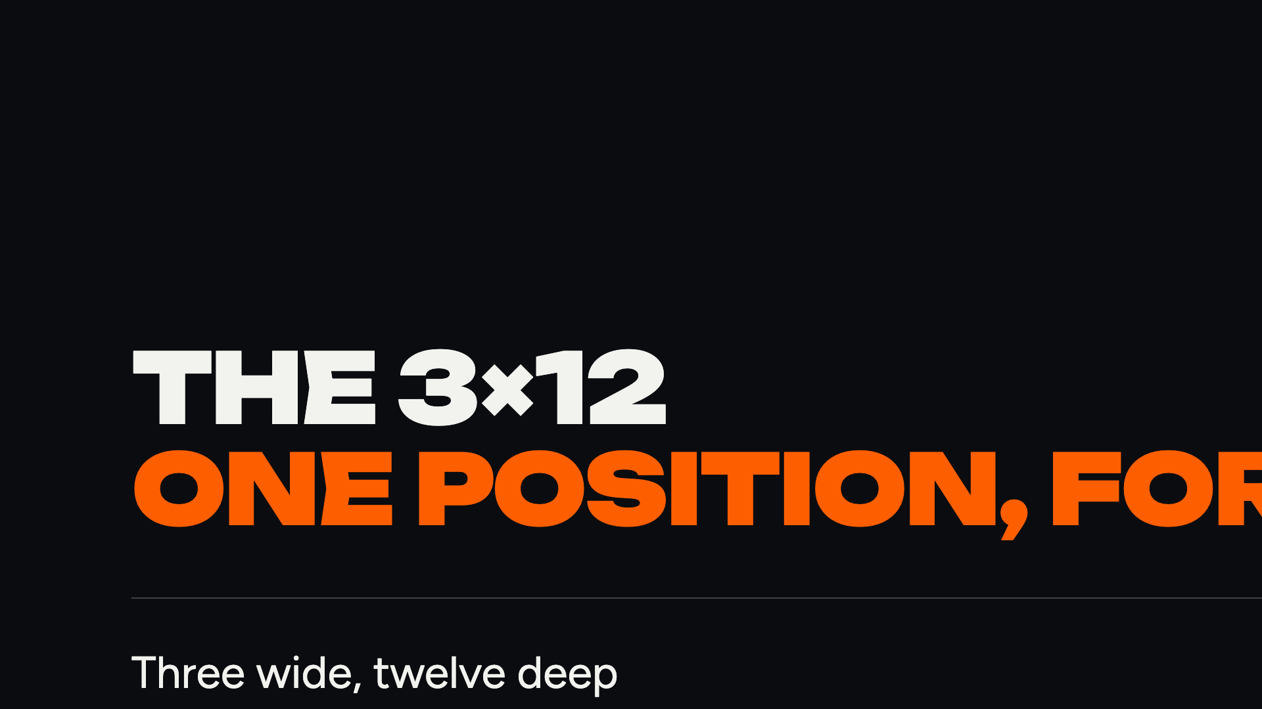



Notes:
One position, placed the first time you subscribe. It never cycles, it only gets deeper. Early placement is the whole timing argument.

Slide 18




Notes:
Every subscription splits three ways, every month. Point at the forty per cent — that is the depth money.

Slide 19




Notes:
The strongest true thing in the plan. Two sales cover the subscription, at any rank, with no organisation.

Slide 20




Notes:
Third direct onward drops to twenty per cent until Go Builder, then fifty returns retroactively on everyone.

Slide 21


Notes:
Open the rank sequence. Getter costs nothing extra: subscribe and three levels are live.

Slide 22
Notes:
Builder is the rank that matters most. Two directs who each get two. It opens three more levels and re-rates every direct to fifty per cent.

Slide 23
Notes:
Leader is a rank you reach by building builders. Four of them.

Slide 24
Notes:
Partner is the top rank. Four leaders. The bottom three levels hold most of the structure — say the ceiling caveat out loud.

Slide 25
Notes:
Bring it back to earth. The top rows are what a real first year looks like.

Slide 26
Notes:
This is the slide that ties the deck together. Package matrices pay the lumps, the subscription pays the floor, and the same organisation feeds both.

Slide 27
Notes:
Recurring is only as durable as the reason people stay. The tool is that reason.

Slide 28
Notes:
Half the credits ever issued are still unspent. That is demand sitting inside the platform waiting for the products that just shipped.

Slide 29
Notes:
Section break into the ask.

Slide 30
Notes:
Itemise it. A subscription plus whichever package you start on. Nothing hidden.

Slide 31
Notes:
Section break into the BIX card bonus.

Slide 32
Notes:
This is the offer for their team. Activate at a hundred dollars or more, keep the subscription active, and we cover the card.

Slide 33
Notes:
Their earnings land on the card itself, in Solana stablecoins, with no load fees. Spend a dollar or a million.

Slide 34
Notes:
A second income line entirely. Every card your team buys and every dollar they spend pays down ten levels.

Slide 35
Notes:
Put the bonus against the record. Eighty-one thousand activations would have been eighty-one thousand cards, eight times the pool threshold.

Slide 36
Notes:
Read this one out, all of it. It costs a minute and it protects everybody in the room.

